Slide 1
Effects of the WaveDriving Course on Car Following: a before-and-after Study in a
Closed Circuit
To understand the dimension and complexity of this project it is necessary to download and visualise it in PowerPoint ®
Konstantinos Mattas¹, Antonio Lucas-Alba², Tomer Toledo³, Óscar Melchor⁴, Shlomo Bekhor³, Biagio Ciuffo¹
(1) European Commission, Joint Research Centre, Italy (2) University of Zaragoza, Spain, (3)Technion -Israel Institute of Technology, (4) Impactware S.L., Spain

Slide 2
Why am I here at this session?
Impact of Individuals, Family, Community, and Technology on Driving Safety and Training
The individual driver can transform traffic flows, traffic jams in particular (and we know how)
Technology is a critical factor in achieving this, with each driver, with millions of drivers
The key factor in changing our understanding of traffic remains education

Slide 3
Contents
Background
Driving to keep Distance
Driving to keep Inertia
Previous studies
The present study
Results
Conclusions
References
Notes:
In order to change traffic flows, traffic jams in particular, the individual driver should learn to Drive to keep Inertia

Slide 4
Background
In 2008 Sugiyama et al., showed in Nagoya that traffic jams can be reproduced artificially. This paradigm has been replicated many times.
In 2018 and 2020 some of us showed that drivers do, as in Nagoya, Drive to keep Distance (DD), but that, after following simple instructions, they can also Drive to keep Inertia (DI).
In 2018 and 2022 we published our first results showing that drivers could learn DI and understand why traffic jams happen by following the WaveDriving Course.
DD and DI are completely different car following techniques. DD adds waves and increases traffic disturbances. DI compensates waves and reduces traffic disturbances.

Slide 5
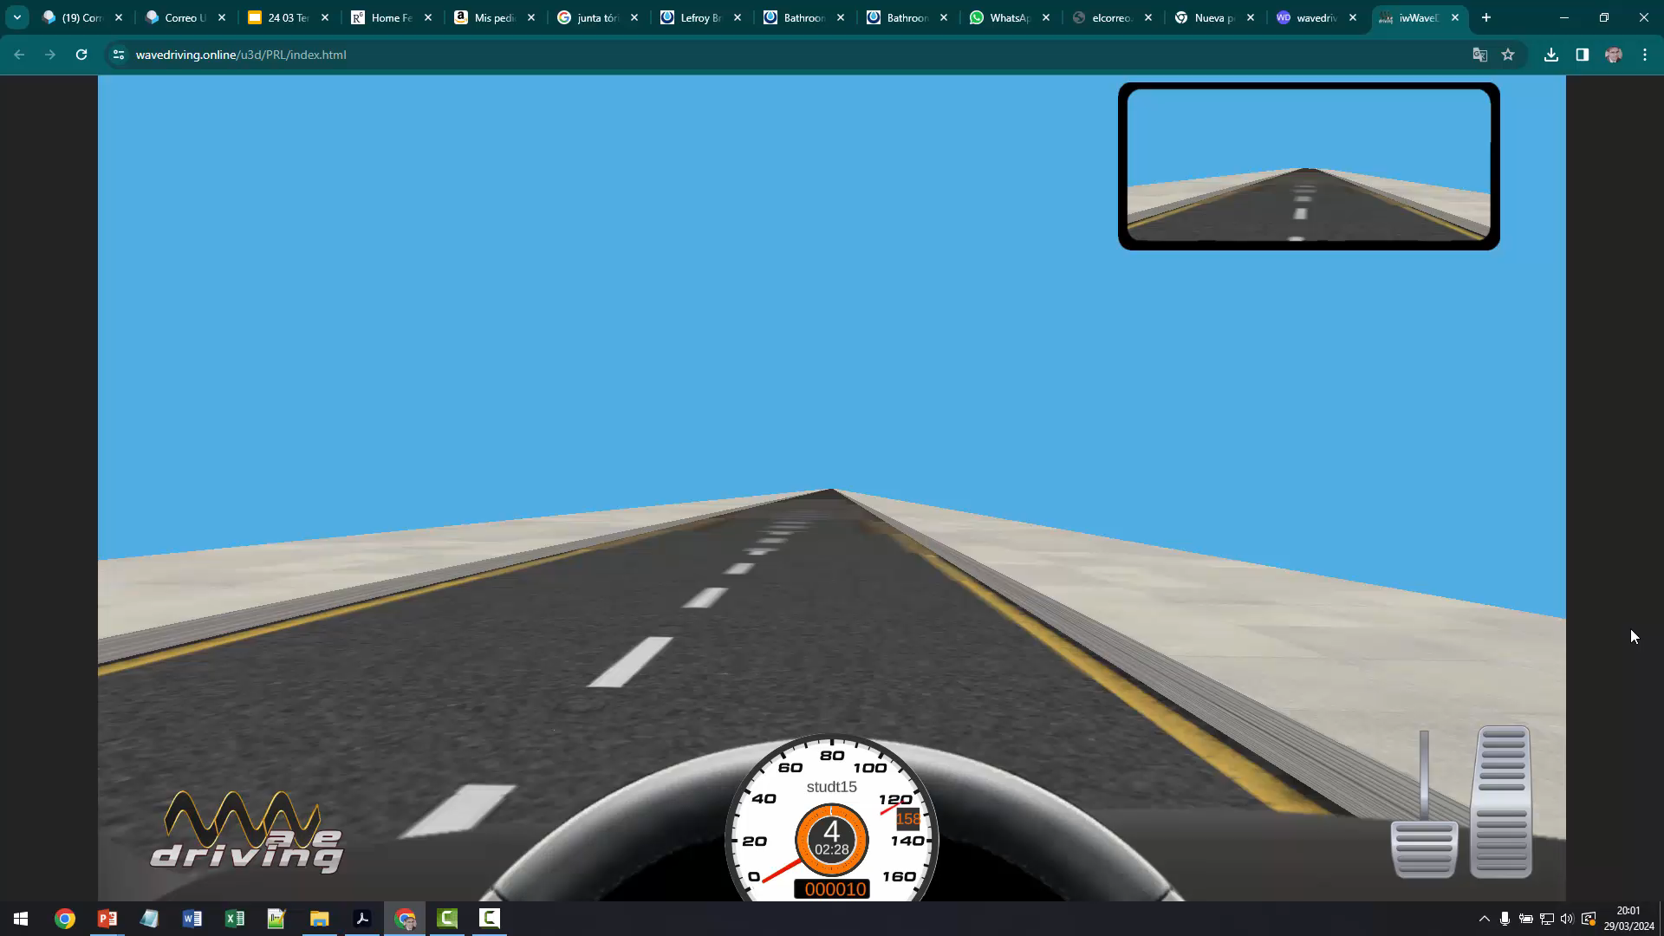
Driving to keep Distance (DD)
This is Driving to keep Distance
The great majority of the 1.2 billion drivers around the world have learned this car-following strategy in driving schools: DD is the default car-following technique
DD both promote and worsen traffic congestions
However, is DD a traffic invariance? No, it isn’t
Notes:
The video shows a driver following the typical stop-and-go leader, either anticipating or already stuck in a traffic jam.

Slide 6
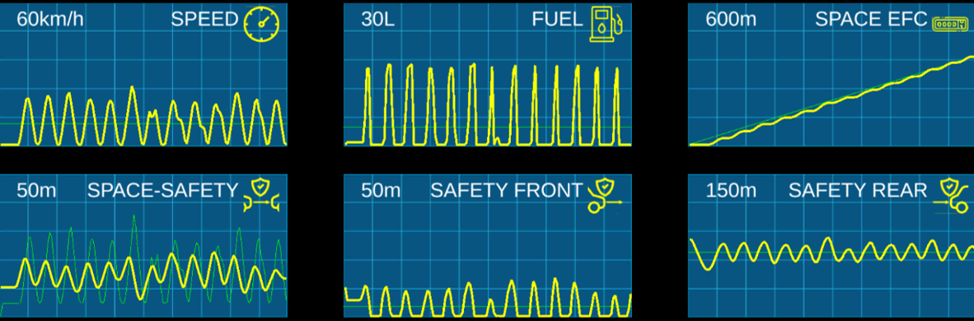
Driving to keep Distance portrayed
(in 6 “electro-car-diagrams”)
Pre-test, before taking the WaveDriving Course: the default car-following technique is DD

Slide 7
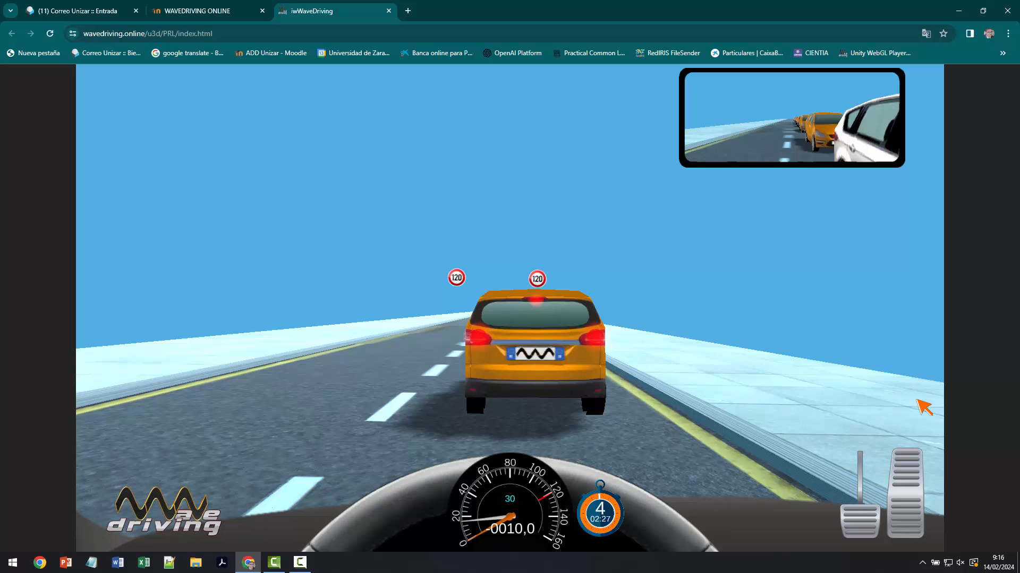
Driving to keep Inertia (DI)
This is Driving to keep Inertia
DI is not yet learned in driving schools, nor is the default car-following technique
However drivers can exhibit DI if we simply ask them to drive in a certain way. Drivers can also learn DI following the WaveDriving Course
DI drivers reduce speed variance, are safer, stabilize followers behind and save petrol
Notes:
The video shows a DI driver following the typical stop-and-go leader, either anticipating or already stuck in a traffic jam.

Slide 8
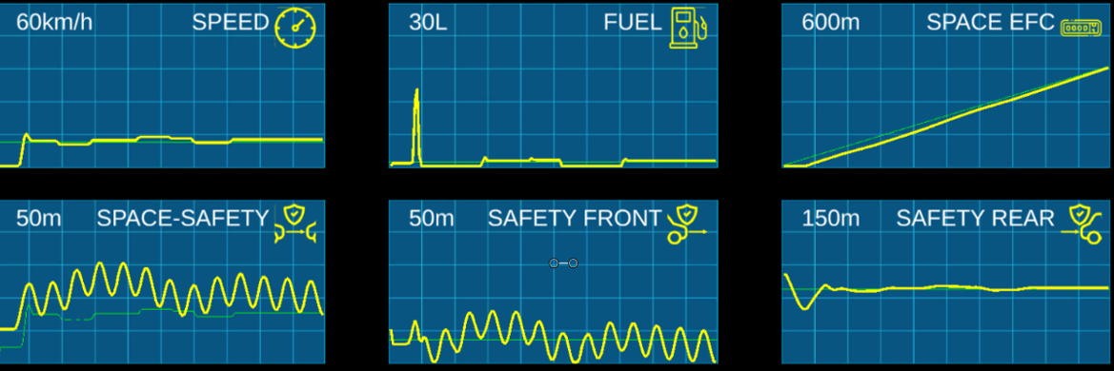
Driving to keep Inertia portrayed
(in 6 “electro-car-diagrams”)
Post-test, after taking the WaveDriving Course: the adopted* car-following technique is DI

Slide 9
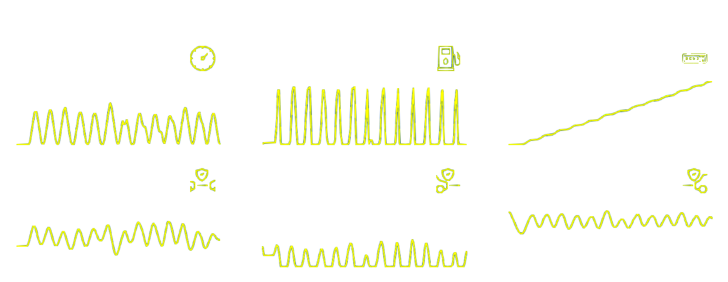
DD and DI Electro-Car-Diagrams compared

Slide 10
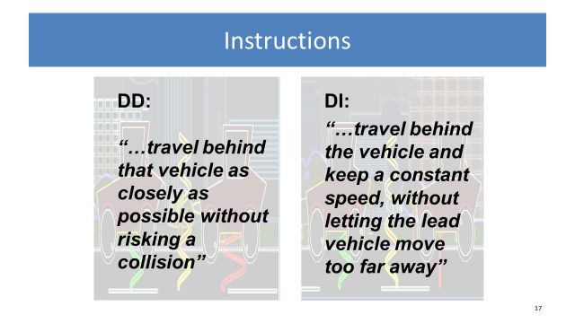
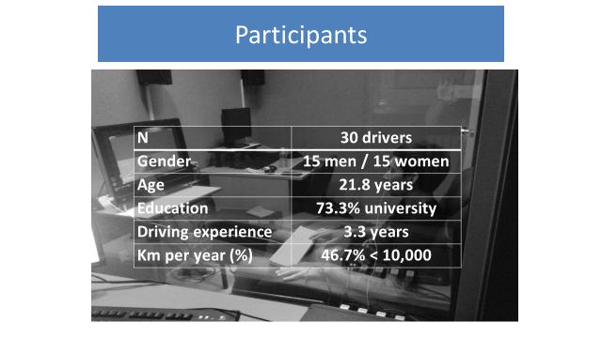
Previous studies (TRB 19-04964)
Can drivers just follow DD or DI under request, or is there a unique Normative Driver Behaviour (NDB) they turn to?
Lucas-Alba, A., Melchor, O. M., Hernando, A., Fernández-Martín, A., Blanch, M. T., & Lombas, A. S. (2020). Distressed in the queue? Psychophysiological and behavioural evidence for two alternative car-following techniques. Transportation Research Part F: Psychology and Behaviour, 74, 418–432. https://doi.org/10.1016/j.trf.2020.09.011
Blanch, M. T., Lucas-Alba, A., Bellés, T., Ferruz, A., Melchor, O., Delgado, L., Ruíz, F., & Chóliz, M. (2018). Car following: Comparing distance-oriented vs. inertia-oriented driving techniques. Transport Policy, 67, 13–22. https://doi.org/10.1016/j.tranpol.2017.05.008

Slide 11
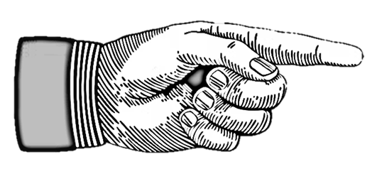
TRB 19-04964
Main results: performance

Driving technique | DD | DI
Number of accelerations | 176.9 | 78.27
Number of decelerations | 119.8 | 51.27
Number of collisions | 1.9 | 0.2
Distance to lead vehicle in m (M) | 5.9 | 11.6
Distance to lead vehicle in m (SD) | 3.7 | 4.23
Speed in m/s (M) | 3.08 | 3.07
Speed in m/s (SD) | 2.6 | 1.4
Virtual fuel consumption (l) | 17.9 | 14.5
<
<
<
<
<
=
<
<
Driving DD means more speed variations and fuel consumption, driving DI involves greater car-following distance.
Notes:
DD and DI differences concerning performance (accelerations, decelerations, crashes, fuel consumption, and so on)
 confirm the results obtained in previous studies.

Slide 12
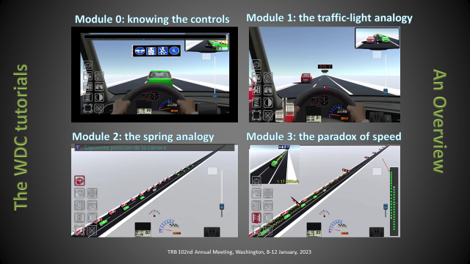
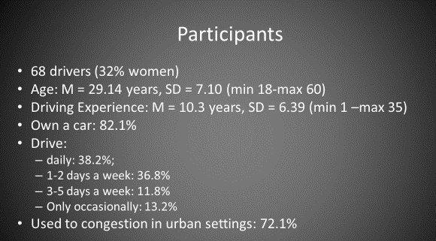
Previous studies (TRB 23-01108)
Can we help drivers understand the complexity of congestion flows and act accordingly? [Testing the WaveDriving Course]
Tenenboim, E., Lucas-Alba, A., Melchor, M. O., Bekhor, S., Toledo, T. (2022). Car following with an inertia-oriented driving technique: A driving simulator experiment. Transportation Research Part F: Psychology and Behaviour 89, 72-83. https://doi.org/10.1016/j.trf.2022.06.003
Lucas-Alba, A., Levy, S., Melchor, O., Zarzoso, A., Blanch, M.T., Lombas, A.S. (2022). Learning an Alternative Car-Following Technique to Avoid Congestion with an Instructional Driving Simulator. IEEE Transactions on Learning Technologies 13, 771-782. https://doi.org/10.1109/TLT.2022.3208003

Slide 13


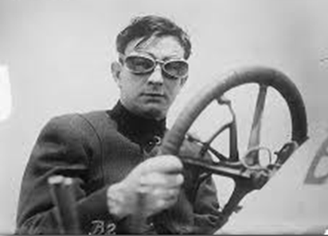



1st
Mental Analogy
Every vehicle is equivalent to a traffic light with wheels: green when it goes forward, yellow when it slows down and red when it stops.
+
Vehicle
“adopting a certain uniform speed allows me to reach the traffic light without stopping, without wasting energy and without perturbing the platoon of cars that follows me”
Notes:
The so-called traffic light analogy, should lead to this cognitive elaboration by the driver: “adopting a certain uniform speed allows me to reach the traffic light without stopping, without wasting energy and without perturbing the platoon of cars that follows me”

Slide 14



2nd
Mental Analogy
Vehicles flow together as if they were hooked on springs: Our reactions are thus transmitted to the rest of the vehicles.
… farewell to phantom traffic jams!
“to follow a leader who continually accelerates and brakes, I need two distances: the safety distance, as always, and also the anti-jam distance, which allows me to constantly adopt the average speed of the leader.”
Notes:
The so-called spring analogy, should lead to this cognitive elaboration by the driver: “to follow a leader who continually accelerates and brakes, I need two distances: the safety distance, as always, and also the anti-jam distance, which allows me to constantly adopt the average speed of the leader”

Slide 15

Summary of results
 | Control group (n = 34) |  | Experimental group (n = 34)
Variables | Pre-test | Post-test | Pre-test | Post-test
D_{L} (m) | 40.39 | 58.73 | 38.39 | 108.73**
D_{D} (m) | 18.05 | 30.26 | 18.84 | 53.86**
S (m/s) | 8.22 | 8.24 | 8.24 | 8.11**
S_{D} (m/s) | 3.32 | 2.92 | 3.38 | 2.21**
F (l) | 11.6 | 8.9 | 11.7 | 6.3**
Table 2. Main performance indicators under Pre-test and Pos-test.
D_{L} = distance to leader; D_{D} = Distance dispersion; S= Speed; S_{D} = Speed dispersion; F = fuel.
No significant differences between Control Group and Experimental Group in the pre-test.
All differences between means were significant at p < .005 in the post-test.
“By default, all drivers assumed the DD technique in the pretest. The experimental group, after going through the tutorial+simulator joint block, adopted the DI technique, which involved a lower speed variance and fuel consumption, and a greater following distance and distance dispersion.”
Notes:
The overall conclusion of the study is that by default, all drivers assumed the DD technique in the pretest. The experimental group, after going through the tutorial+simulator joint block, adopted the DI technique, which involved a lower speed variance and fuel consumption, and a greater following distance and distance dispersion. The average speed of the experimental DI group was significantly lower in the posttest, but we will come to that result later.

Slide 16
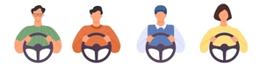
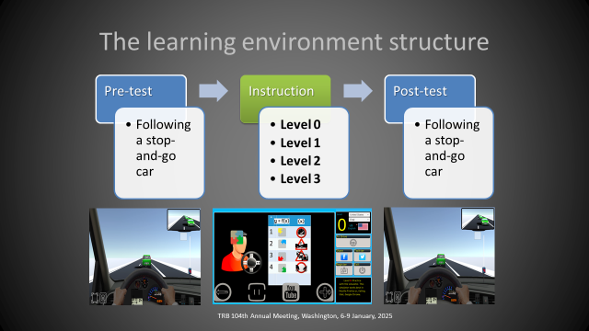
TRB-25-01269: the present study
3 x
Sample: 3 groups of 4 participants each belonging to the JRC (Ispra, Italy)
Pre-test: 1
  (1.1) The group drives around the 3.3 km circuit three times with real cars (L1^{Human}+L2^{ADAS}+4 participants)
  (1.2): The group follows pre-test evaluation in WDC
Intervention: 2 “the WDC lecture”
Post-test: 3
  (3.1) The group follows post-test evaluation in WDC
  (3.2) The group drives around the 3.3 km circuit three times with real cars (L1^{Human}+L2^{ADAS}+4 participants)

Slide 17
WaveDriving Course: Results (N = 11)
Variable | Pre-test (M, SD) | Post-test (M, SD) | t-student (gl, p)
Speed: average (m/s) | 10.01 (2.93) | 10.20 (2.49) | -.995 (10, .343)
Speed: standard deviation (m/s) | 7.59 (1.78) | 3.20 (2.35) | 4.83 (10, .001)
Distance: average (m) | 9.34 (7.85) | 11.30 (6.56) | -.883 (10, .398)
Distance: standard deviation (m) | 11.01 (3.02) | 6.94 (2.22) | 4.08 (10, .002)
Platoon: average (m) | 69.39 (8.40) | 69.85 (7.24) | -.541 (10, .601)
Platoon: standard deviation (m) | 7.75 (1.61) | 3.68 (2.25) | 4.33 (10, .001)
Fuel consumption (l) | 569.78 (269.74) | 224.17 (161.27) | 3.69 (10, .004)
✓
✓
✓
✓
✓

Slide 18
Circuit test: L1^{Human}+L2^{ADAS}+4 participants
1
2
3
4
5
6
3.3 km
Participant: the follower
Participant: the follower
Participant: the follower
Leader ADAS –stops and goes
Leader Human –stops and goes
Participant: the critical follower

Slide 19
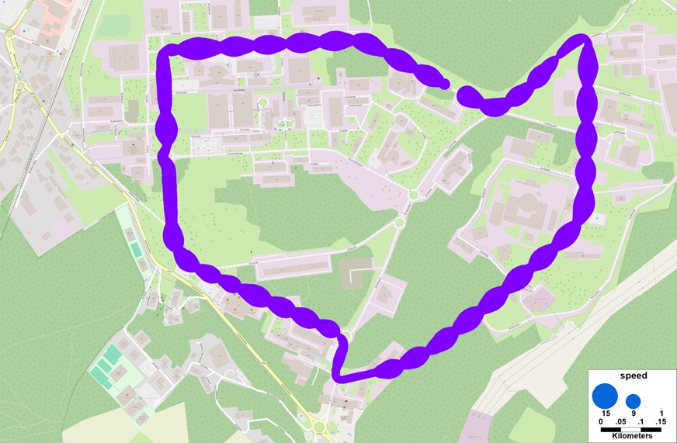
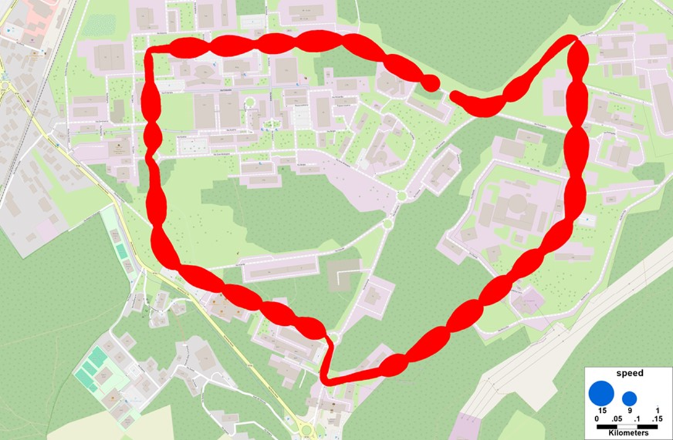
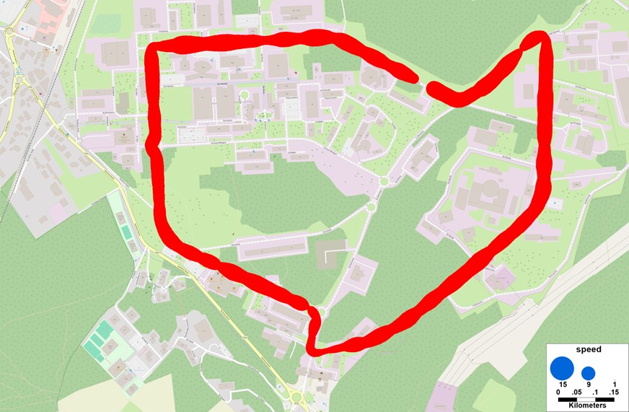
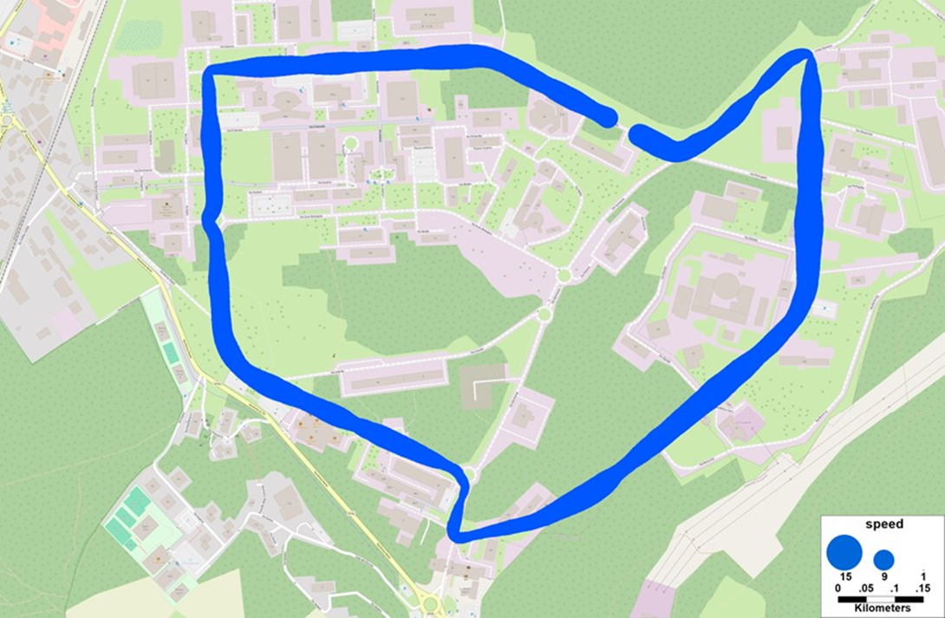
Circuit test: results (team 2, lap 2)
PRE-TEST
POST-TEST
VEHICLE 1
(L^{Human})
VEHICLE 3
(P^{Critical})

Slide 20
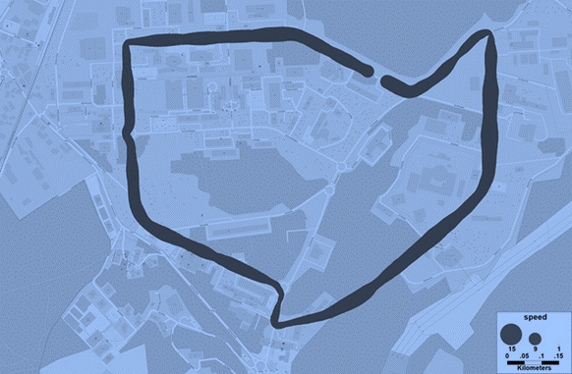
Without Drivers 1 and 2
 |  |  | Average Speed |  | Std speed
Team | Lap | Driver | Pre-test | Post-test | Pre-test | Post-test
1 | 1 | 3 | 8.3 | 7.4 | 2.7 | 2.9
1 | 1 | 4 | 8.3 | 7.3 | 2.8 | 2.9
1 | 2 | 1 | 8.3 | 7.3 | 2.7 | 3.1
1 | 2 | 3 | 8.3 | 7.4 | 2.4 | 2.7
1 | 2 | 4 | 8.3 | 7.3 | 2.5 | 2.7
2 | 1 | 3 | 7.0 | 7.2 | 3.2 | 2.7
2 | 1 | 4 | 7.0 | 7.1 | 3.2 | 2.6
2 | 1 | 6 | 6.9 | 7.0 | 3.3 | 2.5
2 | 2 | 3 | 6.0 | 7.6 | 3.8 | 1.9
2 | 2 | 4 | 6.0 | 7.4 | 3.8 | 1.8
2 | 2 | 6 | 6.0 | 7.5 | 3.8 | 1.5
2 | 3 | 3 | 7.4 | 8.2 | 2.8 | 1.2
2 | 3 | 4 | 7.4 | 8.0 | 2.7 | 1.2
2 | 3 | 6 | 7.5 | 8.0 | 2.8 | 1.2
3 | 1 | 3 | 8.2 | 8.0 | 1.8 | 2.2
3 | 1 | 4 | 8.2 | 8.1 | 1.7 | 2.2
3 | 1 | 5 | 8.2 | 7.9 | 1.7 | 2.2
3 | 1 | 6 | 8.2 | 7.9 | 1.9 | 2.3
3 | 2 | 3 | 8.1 | 8.2 | 2.1 | 2.0
3 | 2 | 4 | 8.1 | 8.4 | 1.8 | 1.8
3 | 2 | 5 | 8.1 | 8.2 | 1.8 | 1.7
3 | 2 | 6 | 8.1 | 8.3 | 1.7 | 1.8
3 | 3 | 3 | 8.2 | 8.0 | 1.8 | 2.1
3 | 3 | 4 | 8.3 | 8.2 | 1.7 | 2.0
3 | 3 | 5 | 8.2 | 8.0 | 1.6 | 2.1
3 | 3 | 6 | 8.3 | 8.1 | 1.2 | 2.2
 |  | Average | 7.72 | 7.77 | 2.43 | 2.13
 |  | Std dev | 0.78 | 0.42 | 0.77 | 0.54
“The data obtained in the closed circuit point in the expected direction, but the sample used was small and lacked a sufficient number of third participants.”

Slide 21
Conclusions
The study carried out at the JRC in Ispra (Italy) is the first that aims to verify the short-term effects of learning DI with real cars and drivers on a closed circuit, simulating heavy traffic conditions.
Although the study was conducted with a small group of participants, the effects of the WDC were very similar to those obtained in previous studies with substantially larger samples.
The data obtained in the closed circuit are suggestive and point in the expected direction, but the sample used was small and the participant structure lacked a sufficient number of third participants.
The strong results in terms of DI learning obtained in all studies suggest that the adaptation of this learning to real traffic conditions needs to be further and consistently explored.

Slide 22
References
Sugiyama, Y., Fukui, M., Kikuchi, M., Hasebe, K., Nakayama, A., Nishinari, K., Tadaki, S., & Yukawa, S. (2008). Traffic jams without bottlenecks experimental – evidence for the physical mechanism of the formation of a jam. New Journal of Physics 10 (033001), pp. 1-7.
Blanch, M.T., Lucas-Alba, A., Bellés, T., Ferruz, A., Melchor, O., Delgado, L., Ruíz, F., Chóliz, M. (2018). Car following: Comparing distance-oriented vs. inertia-oriented driving techniques. Transport Policy, 67, pp. 13-22.
Melchor, O., Lucas-Alba, A., Ferruz, A.M., Blanch, M.T., & Martin-Albó, J. (2018). The WaveDriving Course. Transportation Research Procedia 33, pp. 179-186.
Lucas-Alba, A., Melchor, O.M., Hernando, A., Fernández-Martín, A., Blanch, M.T., Lombas, A.S. (2020). Distressed in the queue? Psychophysiological and behavioral evidence for two alternative car-following techniques. Transportation Research Part F: Psychology and Behaviour 74, pp. 418-432.
Lucas-Alba, A., Levy, S., Melchor, O., Zarzoso, A., Blanch, M.T., Lombas, A.S. (2022). Learning an Alternative Car-Following Technique to Avoid Congestion with an Instructional Driving Simulator. IEEE Transactions on Learning Technologies 13, pp. 1-13.
Tenenboim, E., Lucas-Alba, A., Melchor, M. O., Bekhor, S., Toledo, T. (2022). Car following with an inertia-oriented driving technique: A driving simulator experiment. Transportation Research Part F: Psychology and Behaviour 89, pp. 72-83.

Slide 23
Many thanks for your attention!
lucalba@unizar.es
oscar.melchor@impactware.com

