Slide 1
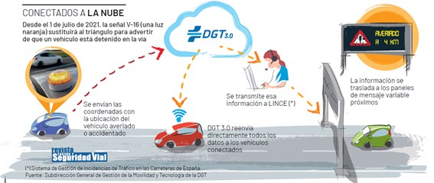
V-16 SIGNAL FUNCTIONING

