Slide 1
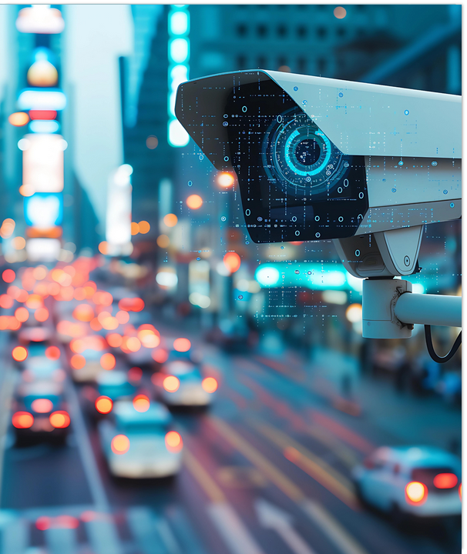
The driver’s
6 Electro-Car-Diagrams
European Road Safety Charter
2024

Slide 2
Id Title
Summary
Benefits
Compatibility
Equations
Distance vs Inertia
Analogical Reasoning
Process
The 6 Electro-Car Diagrams
How are they obtained?
Who is it aimed at?
Autonomous Vehicle / Connected Vehicle
How is the miracle achieved?
Curiosity
Phantom Traffic Jam
Recognitions and Achievements
Scientific Articles
Conferences
Traffic Engineering
Sustainability
Eliminating a real traffic jam
Emotions
Press
Acknowledgements
Summary
"It is mathematically impossible to drive with the idea of maintaining a safe distance and not causing traffic jams."
We are the traffic engineering team that has generated the new equations for a new mobility. Eliminating the dynamics of a traffic jam in just 10 seconds or making it disappear with the sole behavior modification of one driver are achievements we have demonstrated some time ago.
However, the most outstanding part of our work is that we have created the 6 Driver's Electro-Car Diagrams.
PAGE 01

Slide 3
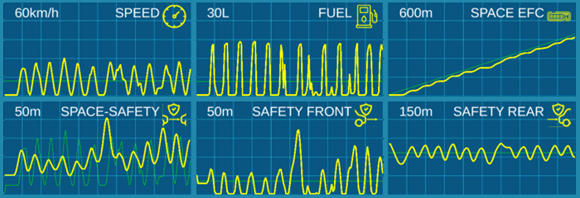
Benefits
This represents a milestone that could change the world of education in Road Safety, Mobility, and Sustainability, for which we received the National Award for Occupational Risk Prevention in Spain in 2019 (pre-COVID).
These 6 ECDs derive from our demonstration that, in terms of lane mobility, a driver is nothing more than a wave, and if we project that wave onto six different planes, we obtain as many ECDs.
Studies conducted over the past 10 years have shown that when drivers understand traffic dynamics and know themselves through the ECDs, the following occurs:
Fuel consumption and pollutant emissions decrease.
Accident rates decrease.
Stress and anxiety while driving diminish.
So-called Phantom Traffic Jams vanish.
Travel times got reduced.
Driver fatigue diminishes.
The efficiency of infrastructure is improved.
Enhances safety in emergency situations, such as population evacuations.
Creates awareness of collective driving.
PAGE 02
PAGE 03

Slide 4
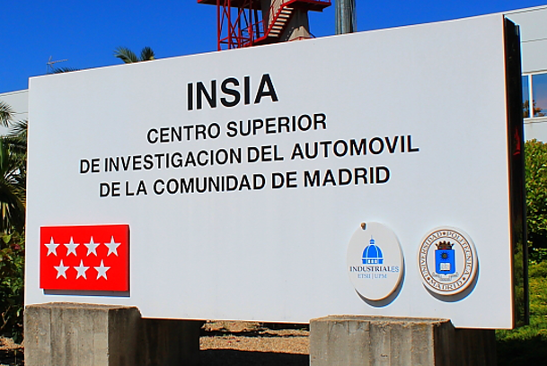
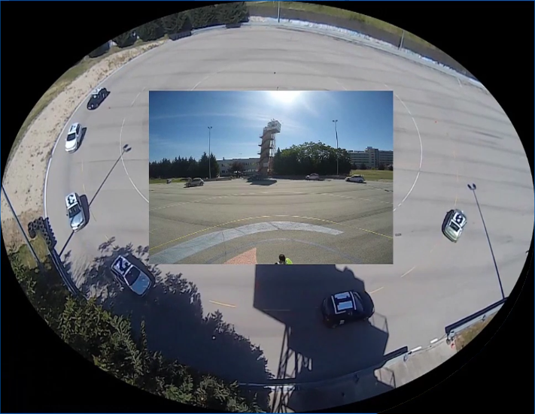
Compatibility
Inertial driving is compatible with:
All traffic regulations in all countries.
All types of vehicles: heavy or light.
All fuels: fossil or electric.
All drivers: human or autonomous.
All safe driving techniques, such as preventive and defensive driving.
Connected vehicles.
PAGE 04
On May 6, 2015, we eliminated the dynamics of a traffic jam in 10 seconds by giving a message to a single driver.
PAGE 05

Slide 5
Equations
“The movement wave of a vehicle traveling in a lane is the movement wave of the vehicle ahead plus the wave of its driver.”
W follower = W leader + W driver
What do we do in our course?
We modify the driver's wave!
PAGE 12
PAGE 13

Slide 6
From the previous equation, we draw the following conclusions: for there to be no traffic jams, every driver must meet the following conditions:
Never get closer than a safe distance.
Maintain the highest possible average speed.
Keep a uniform speed.
Occupy only the necessary space to meet the above conditions.
From a mathematical point of view, each condition is an equation, and for the system to have a solution, the driver must use as many variables as there are equations: 4.
However, the driver who drives with the idea of maintaining a safe distance uses only two variables:
1. Speed
2. Safe Distance
That is why phantom traffic jams occur:
4 equations vs 2 variables
How do we solve it?
PAGE 14
PAGE 15

Slide 7
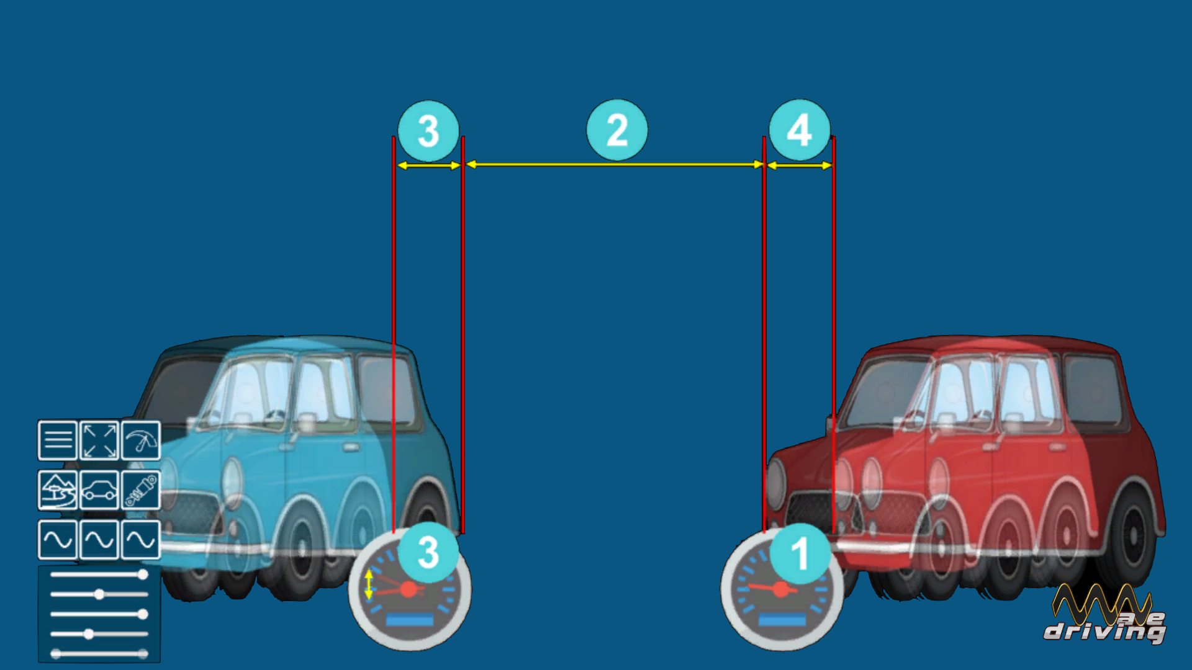
Drive to keep ‘distance’ vs ‘inertia’
For the system to have a solution, it is necessary to use another way of interpreting the movement in the lane: ‘inertial driving’ which uses 4 variables:
1. The average speed variable.
2. The usual safe distance variable.
3. The speed adaptation variable.
4. The required space adaptation variable.
But all this sounds very complex. If driving with two variables is already complex, how are we going to add two more variables?
TD: Traditional Driving or ‘Distance’
WD: Wavedriving® or ‘Inertial’ Driving
---
The 4 variables.
PAGE 16
PAGE 17

Slide 8
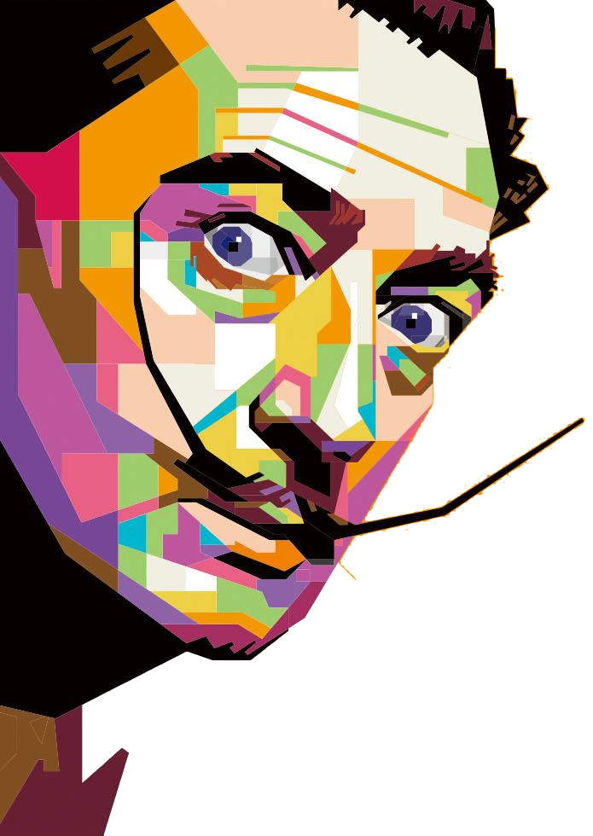
Analogical Reasoning
It is common to use mental analogies to explain certain physical phenomena to students. For example, to explain the law of gravitation, it is said that it is as if the earth were a large magnet and objects were metallic elements attracted to it.
In psychology, this is called analogical reasoning.
Therefore, to help drivers understand traffic dynamics, we will use simple analogies that allow an immediate understanding of the physical phenomenon we want to explain.
PAGE 18
PAGE 19

Slide 9
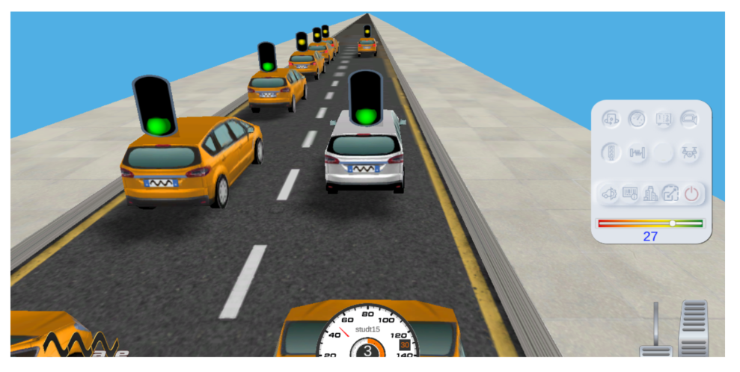
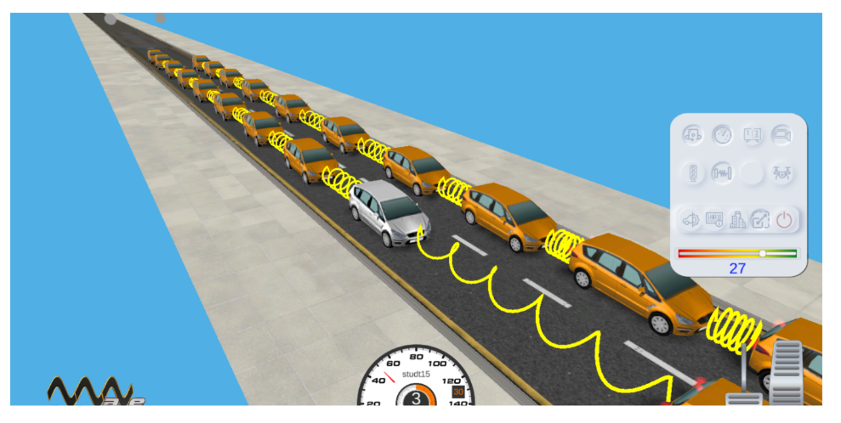
1st Analogy
2nd Analogy
"A vehicle is nothing more than a traffic light on wheels:
Green when moving.
Yellow when braking.
Red when stopped."
"Vehicles do not move because they have a driver controlling them, but because they are connected by springs to the lead vehicle.".
PAGE 20
PAGE 21

Slide 10
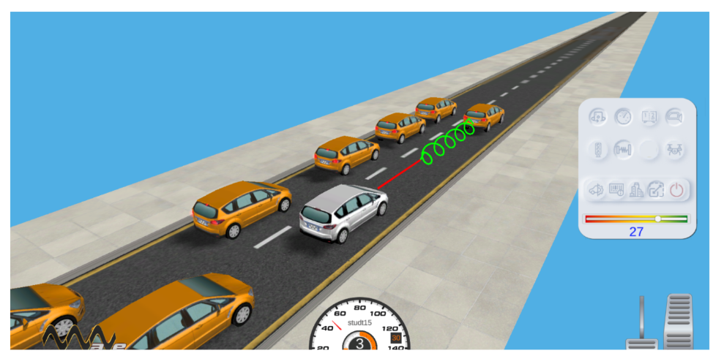
3rd Analogy
Process
"When you are following another vehicle, you should imagine that your vehicle has two elements on its front:
A rigid bar that represents the safety distance.
A spring that represents the variable space needed to adjust your speed."
The process that has given the best results to understand traffic dynamics has been the following:
ECD self-assessment.
One active lane, Leading Player: Visualize how your speed changes affect the vehicles that follow you.
Two active lanes, Leading Player: Learn to time with traffic lights in sequence. Comparison with (incorrect) bots strategy occurring in parallel in the second lane.
Two active lanes, second vehicle Player: Learn to synchronize with the preceding vehicle. Comparison with (incorrect) bots strategy in parallel in the second lane.
ECD self-assessment.
PAGE 22
PAGE 23

Slide 11
The 6 Electro-Car-Diagrams
Our students take two mandatory evaluation tests:
Before starting the training.
At the end of the training.
Since the ECDs indicate the 'flaws' in their driving, they can subsequently take as many tests as they wish to perfect their technique. This way, when they are on the 'real' road, they will be able to apply all the knowledge learned.
Observe the ECDs at the top. They correspond to the same driver who took our course.
Do you notice any changes between them?
Which one seems to be safer, consume less fuel, and be less stressful?
PAGE 24
PAGE 25

Slide 12
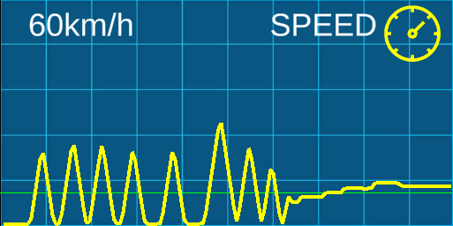
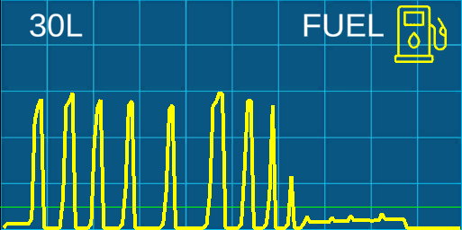
ECD Efficiency in Speed
ECD Efficiency in Consumption/Emissions
We are showing, from left to right within the same graph, the result of the two lane-driving techniques. We can see the differences:
TD: Highly variable speed, then
WD: Minimally variable speed.
TD: Very high consumption due to having to give impulse to the vehicle, then
WD: Minimal consumption.
PAGE 26
PAGE 27

Slide 13
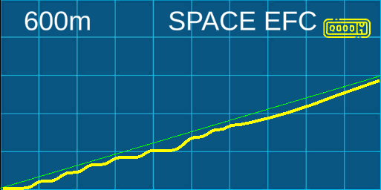
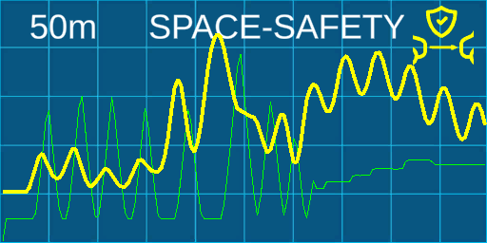
ECD Efficiency in Space
ECD Managing Distances
It should be interpreted vertically; the distance between the green and yellow lines indicates the amount of 'asphalt' we need in our driving:
TD: Very variable with many stops and starts.
WD: Slightly variable and continuous flow.
In this graph, two lines converge:
Green: the (safety) distance we need.
Yellow: the distance we are actually leaving.
TD: Areas where the green is above => Unsafe.
WD: Has not invaded the safety distance => Safe..
PAGE 28
PAGE 29

Slide 14
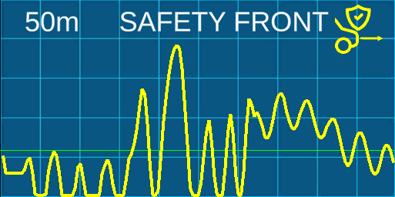
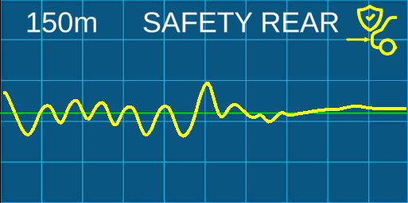
ECD Road Safety in FRONT
ECD Road safety REAR
If the waves valleys are flat, it indicates the moments in which the safety distance was not maintained:
TD: Several sections with flat valleys => Unsafe.
WD: No flat valleys => Safe.
This graph indicates what the driver is causing in the platoon following him/her:
TD: Causing sudden braking and acceleration => Unsafe.
WD: Generating 'calm traffic' => Safe.
PAGE 30
PAGE 31

Slide 15
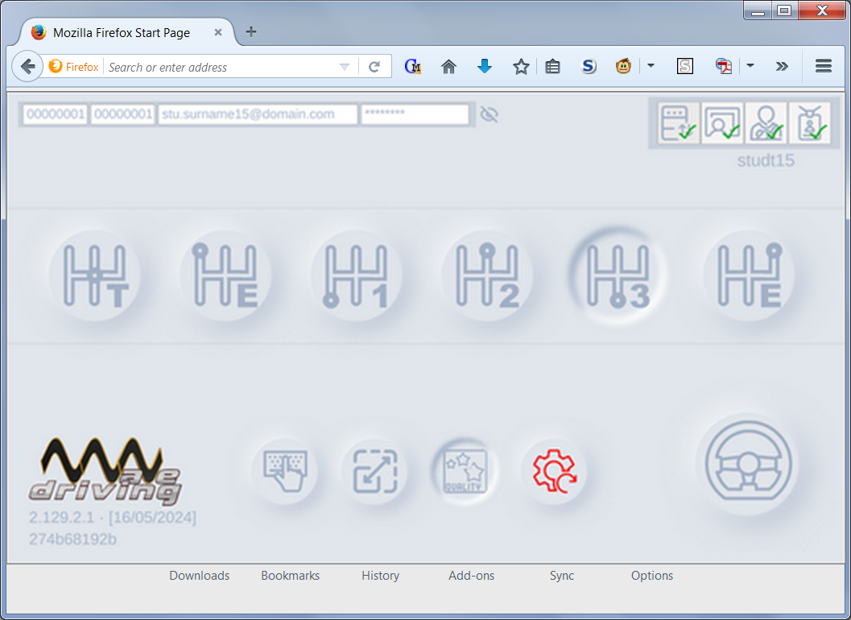
6 ECD How are they obtained?
Different devices connected to a computer are not necessary to obtain the 6 ECDs of a driver, just visit our website.
You only need any of these common objects:
Mobile phone.
Tablet.
Personal computer / Laptop.
Upon entering the simulator's website, as the driver reacts to the different elements that appear on the scene, the system automatically collects the corresponding values (speed, consumption, distances…) to later display them in a graphical form.
Super simple!
PAGE 32
PAGE 33

Slide 16
Who is it addressed to?
In reality, lane mobility goes beyond just having your hands on the steering wheel. Let's remember that the origin of the equations comes from caterpillars that move in a line. We should learn from them. They move without pushing each other.
It has been proven that adding two new variables to a person's mind and brain is permanent, much like riding a bicycle; it is a lifelong learning experience.
Unfortunately, there are situations where Civil Protection must organize an emergency evacuation, and we, the citizens, must help them so they can help us. It is vital to understand and participate in collective movement.
Therefore, inertia-oriented driving should be made known in:
Schools and Universities.
Companies, whether they are transporters or not.
Health Centers (Hospitals, Emergency Services, etc.)
Driving Schools, naturally.
PAGE 34
PAGE 35

Slide 17
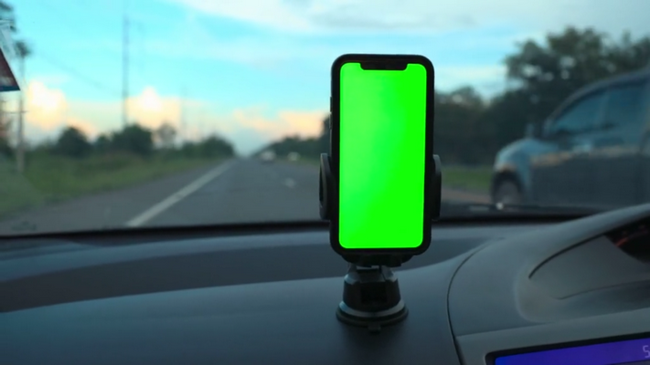
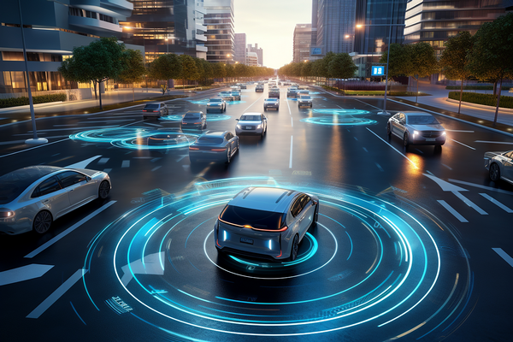
Autonomous Vehicle / Connected Vehicle
Every behavior of a driver is reflected in the ECDs, and the autonomous vehicle also has its own driver, even if it doesn't have a face.
Currently, we are developing:
Advance Driver Assistance for the driver by incorporating it into a smartphone (applications like Waze® etc.).
Advance Driving Assistance in an embedded device.
Part of the software in the vehicle's AI.
There will come a day when every vehicle on the road will have, at least optionally, the possibility of autonomous driving. However, until that day arrives, the smartphone, when used properly, will be a great ally.
PAGE 36
PAGE 37

Slide 18
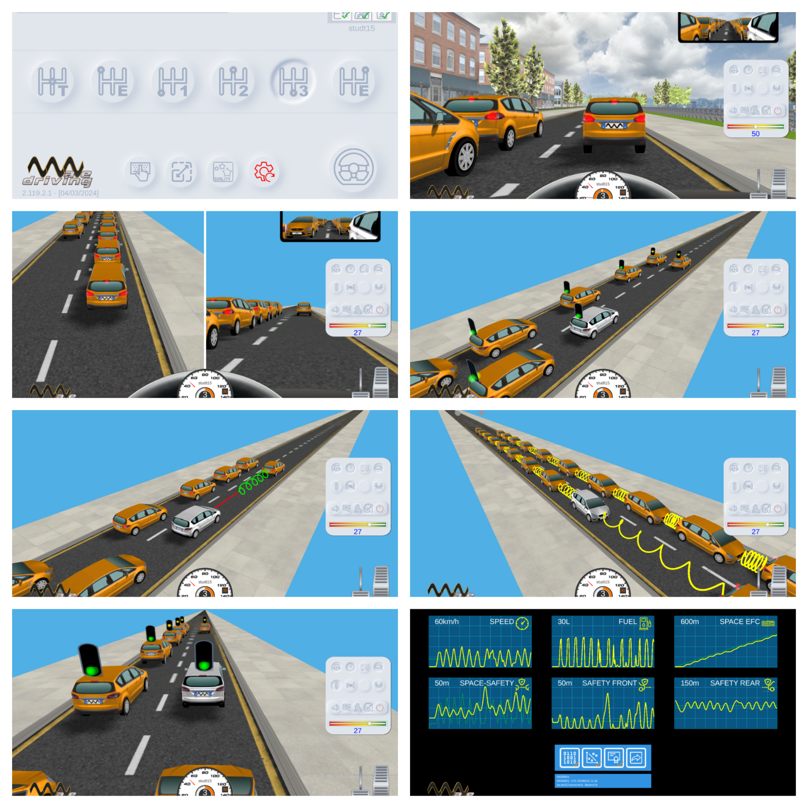
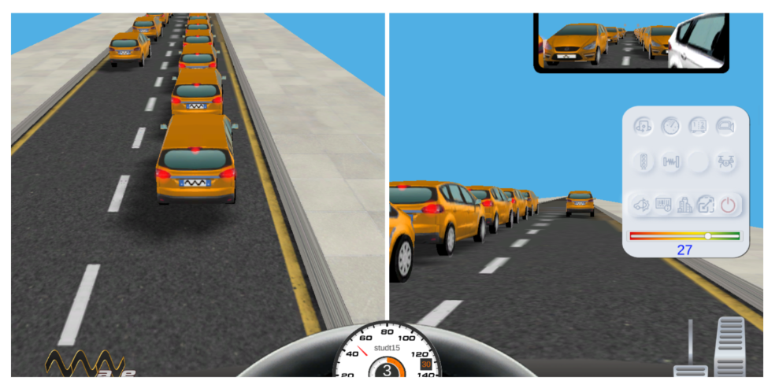
How is the miracle worked?
How, in a few minutes, can drivers change their behavior forever? By using two techniques:
1) At all times, the student-driver observes a lane to the left where vehicles with traditional driving operate.
In this way, they compare what happens when driving with one technique or another.
2) Having ADAS that will show the traffic dynamics from perspectives that would otherwise be almost impossible to imagine.
PAGE 38
PAGE 39

Slide 19
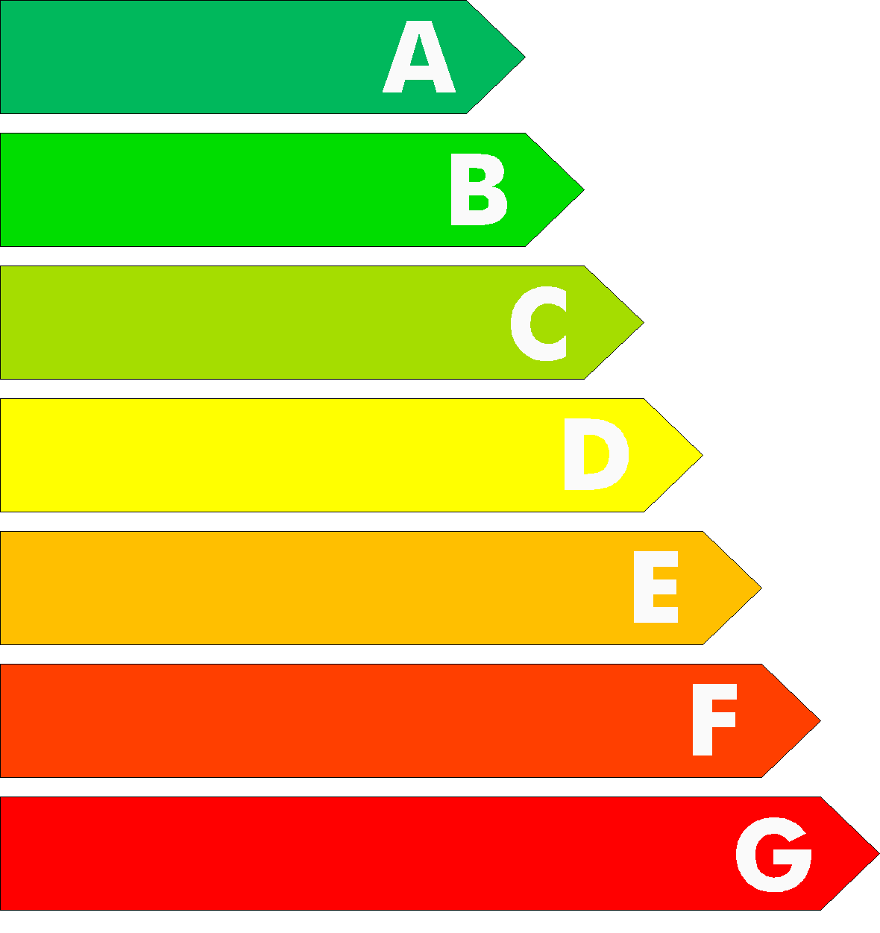
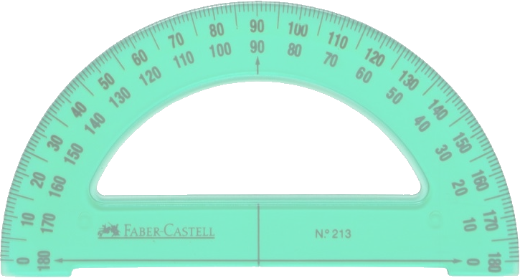
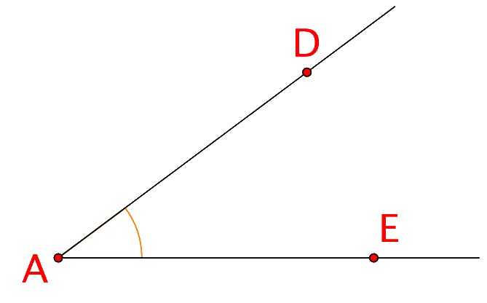
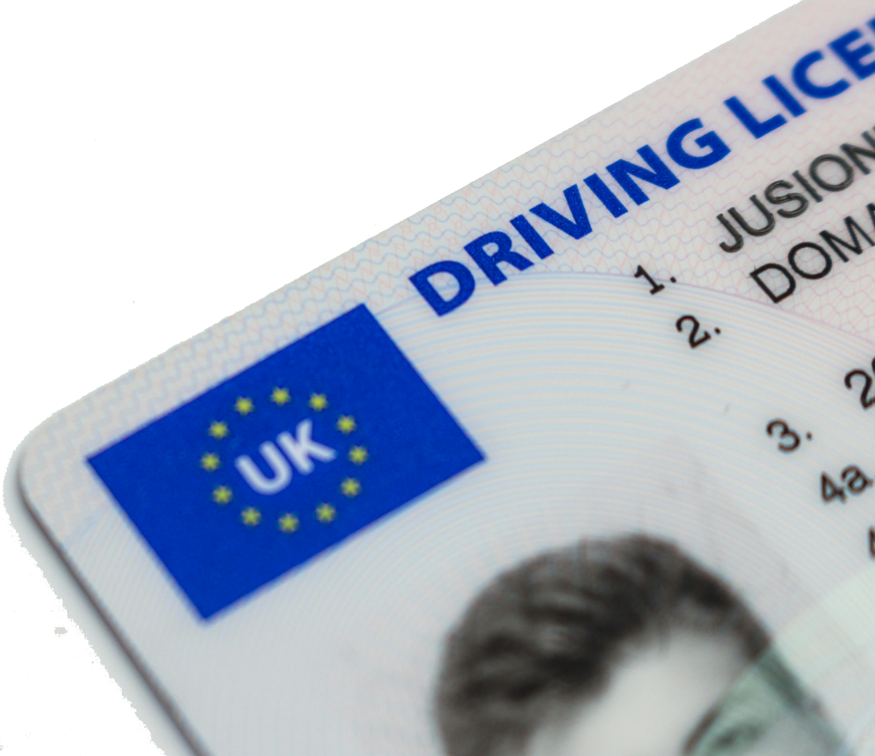
Curiosity
We previously saw the ECD of speed, but could you tell us what units it is measured in?
Well, although it seems incredible, the efficiency of speed is...
an angle!
Similarly, the reaction time of a driver (approximately 0.75s) could also be expressed in radians.
Due to the wave interpretation of the movement in the lane, we can establish a comparison between the vehicle’s wave and the driver’s wave, and from this comparison, obtain the value of the phase shift... which is an angle α.
PAGE 40
PAGE 41

Slide 20
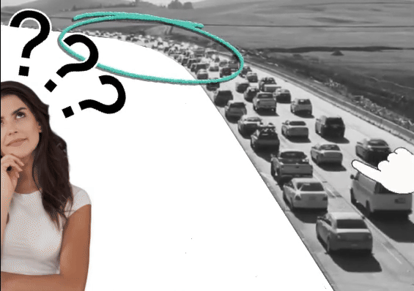
Phantom traffic jam
If we stayed only in theory, this knowledge would hardly make sense. In the classrooms, alongside the use of the Web Simulator and as a complement to it, videos are shown with real examples of:
FRONT accidents.
REAR accidents.
Phantom traffic jams.
Unstable dense traffic.
Lane blocking.
Etc.
According to our estimates, if just one in every fifty (1/50) drivers practiced inertial driving, 20% of the traffic jams on our roads would disappear.
PAGE 42
PAGE 43

Slide 21
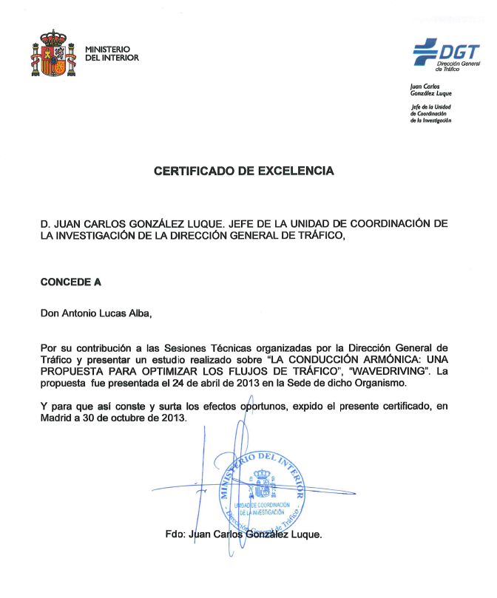
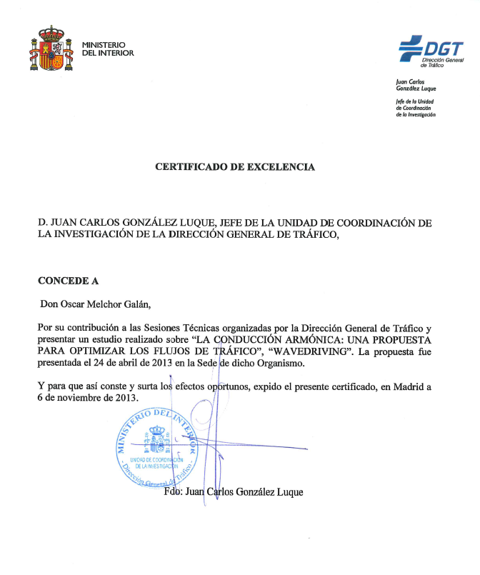
Recognitions and Achievements
Behind this engineering, there are many years of effort in the labor, economic, technological, and personal fields.
Many of us have put our efforts into achieving the dream of finally understanding traffic dynamics and, at the same time, being able to teach it to other drivers, to the world.
In the following pages, we will show some of the recognitions that have been awarded to us over the years. Leaving some out should not be seen as a shortcoming on our part, but rather to avoid making the document excessively long.
DGT Certificates of Excellence
PAGE 44
PAGE 45

Slide 22
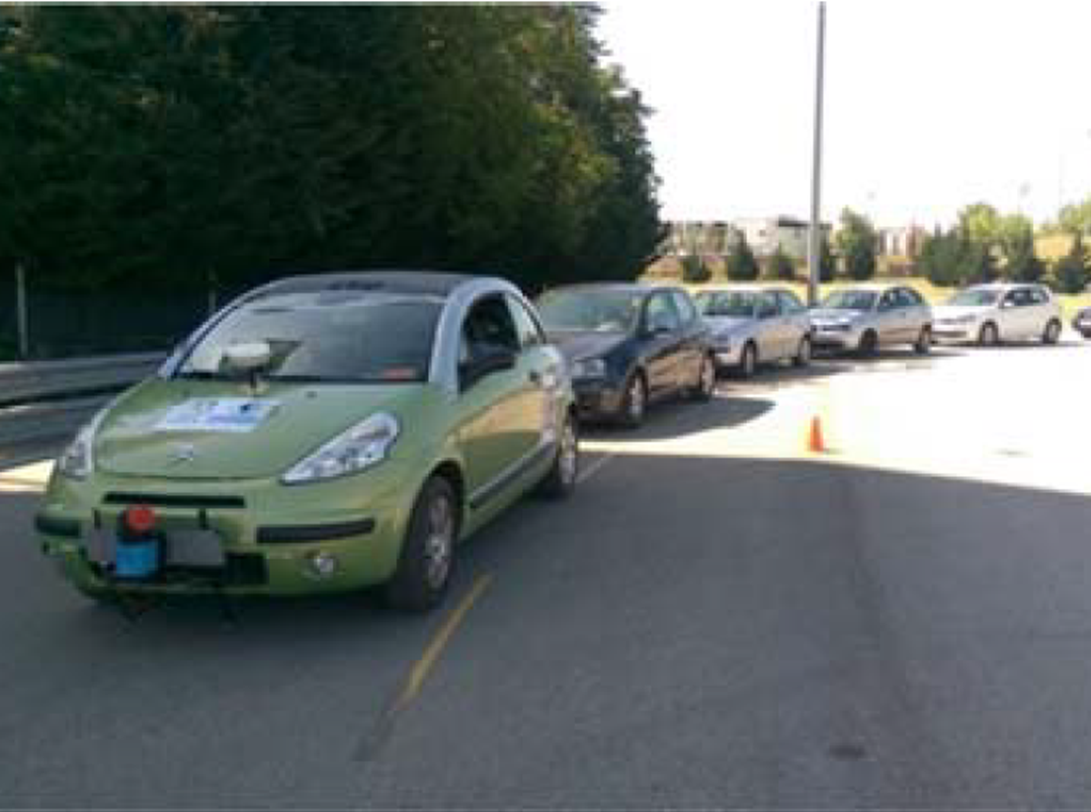
Civil Protection
When the Security Forces provide their services in civil assistance, whether in our own country or another, and it is necessary to evacuate the population, our engineering offers optimal management of the movements.
INSIA
Ten seconds were enough to modify the behavior of a single driver and eliminate the traffic jam dynamics.
PAGE 46
PAGE 47

Slide 23
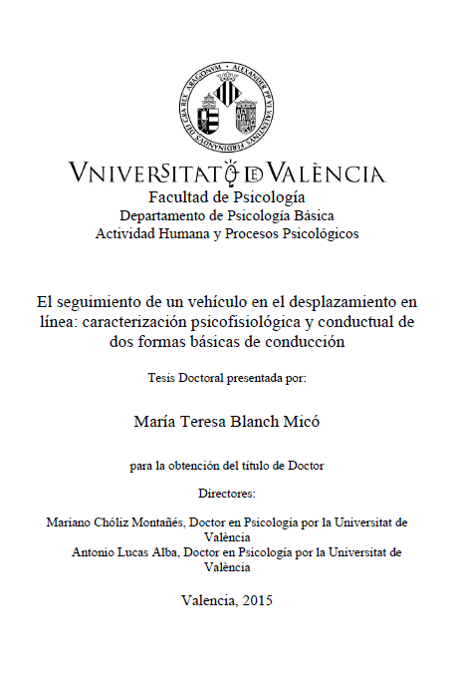
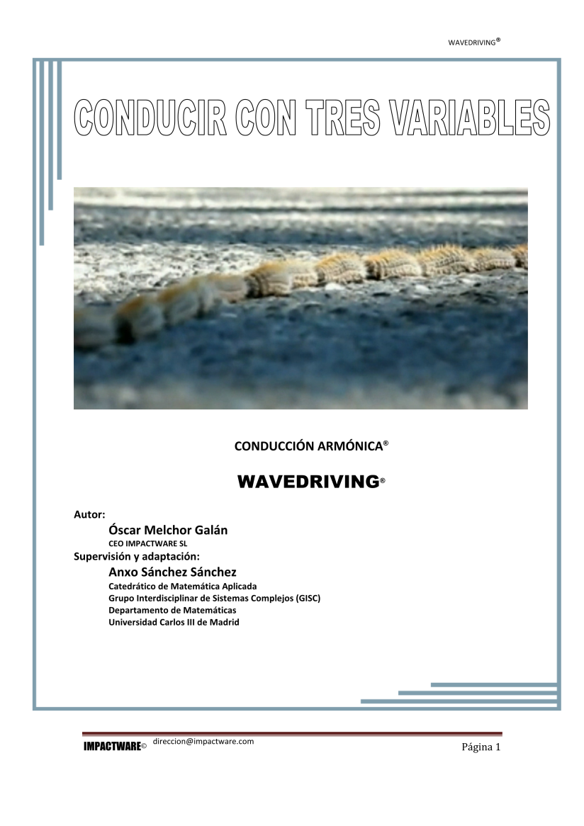
Mathematics Certification. Universidad Carlos III de Madrid
Copying the equations for movement on the track of the pine processionary caterpillar (Thaumetopoea pityocampa),
Cognitive Certification. Universitat de València
Doctorate.
PAGE 48
PAGE 49

Slide 24
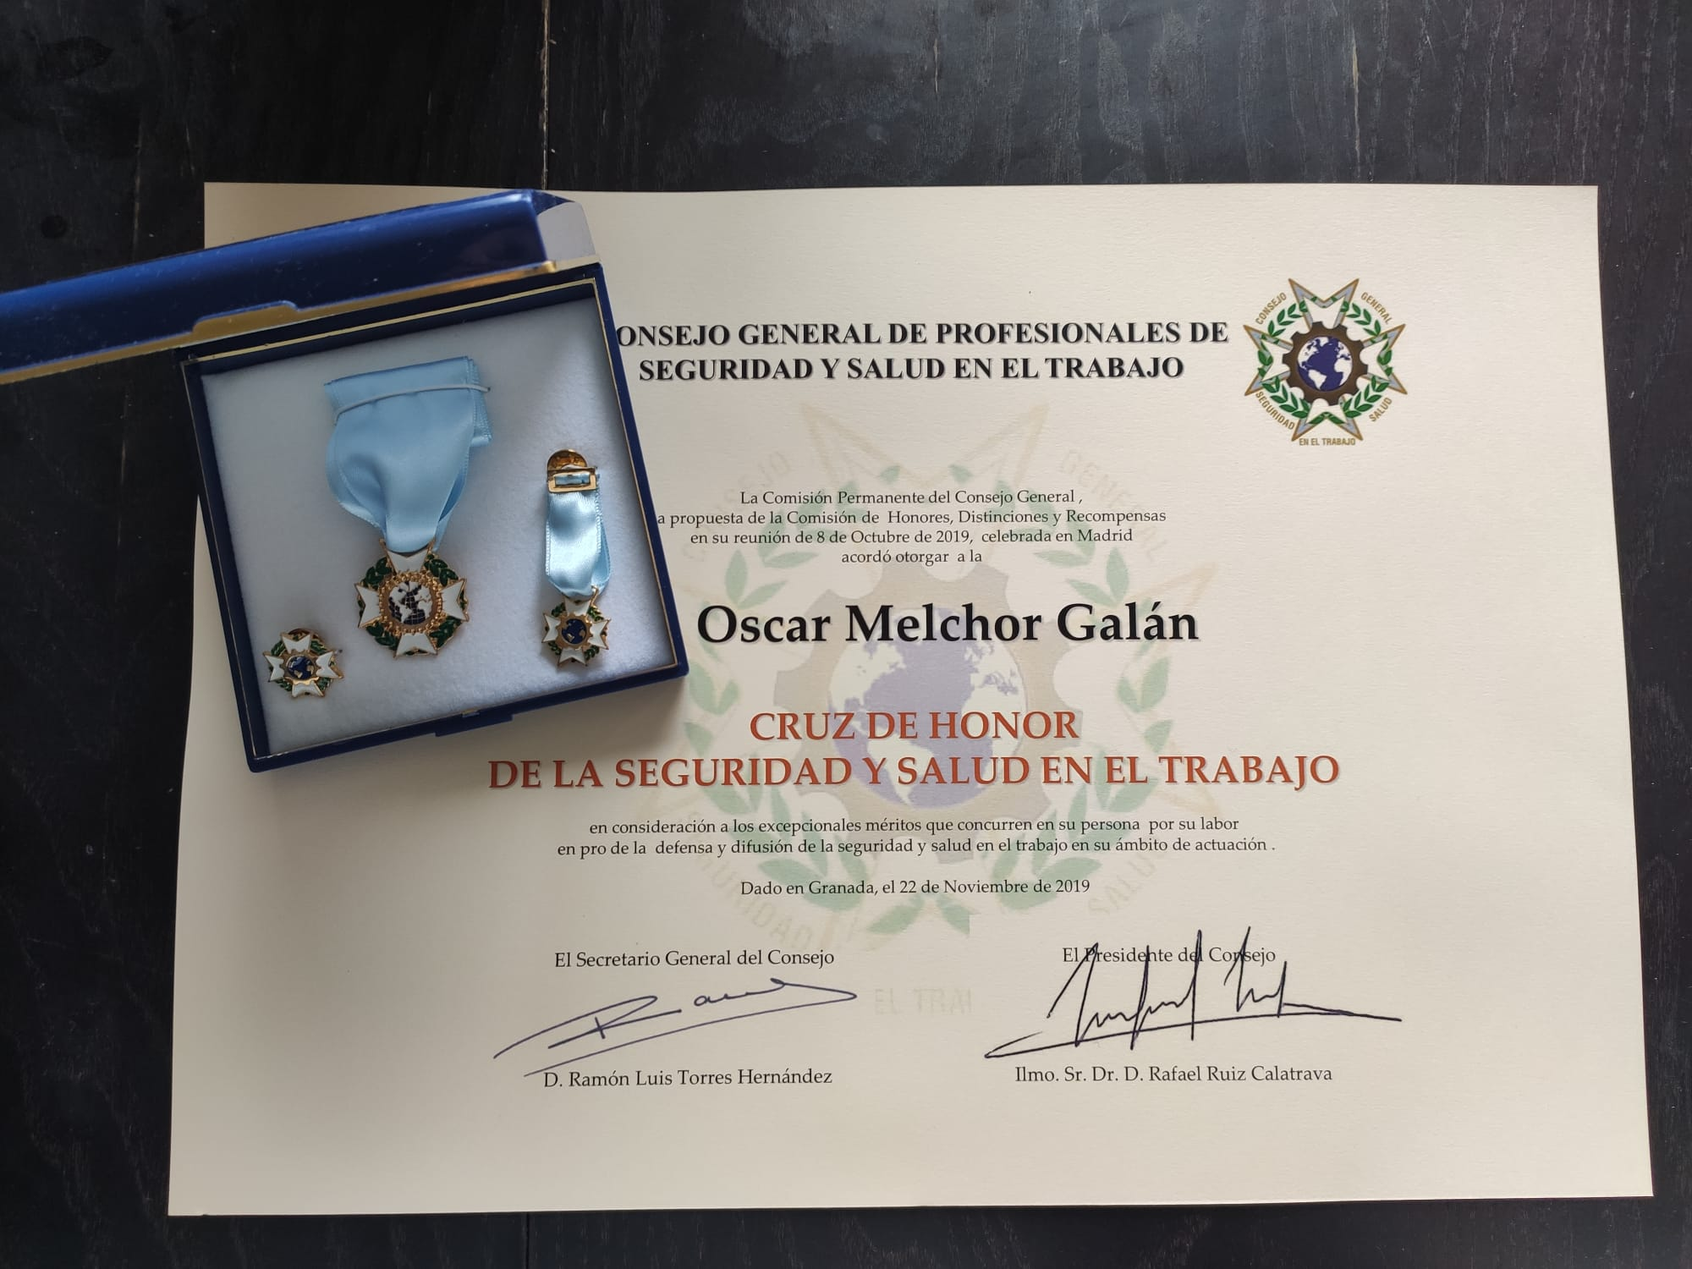
National Award PREVER
In the field of Occupational Health and Safety, 'driving protocol'.
Universidad de Granada
Cross of Honor for Occupational Health and Safety.
Although it's nominative, it's an award for the entire team for the years of effort put in.
PAGE 50
PAGE 51

Slide 25
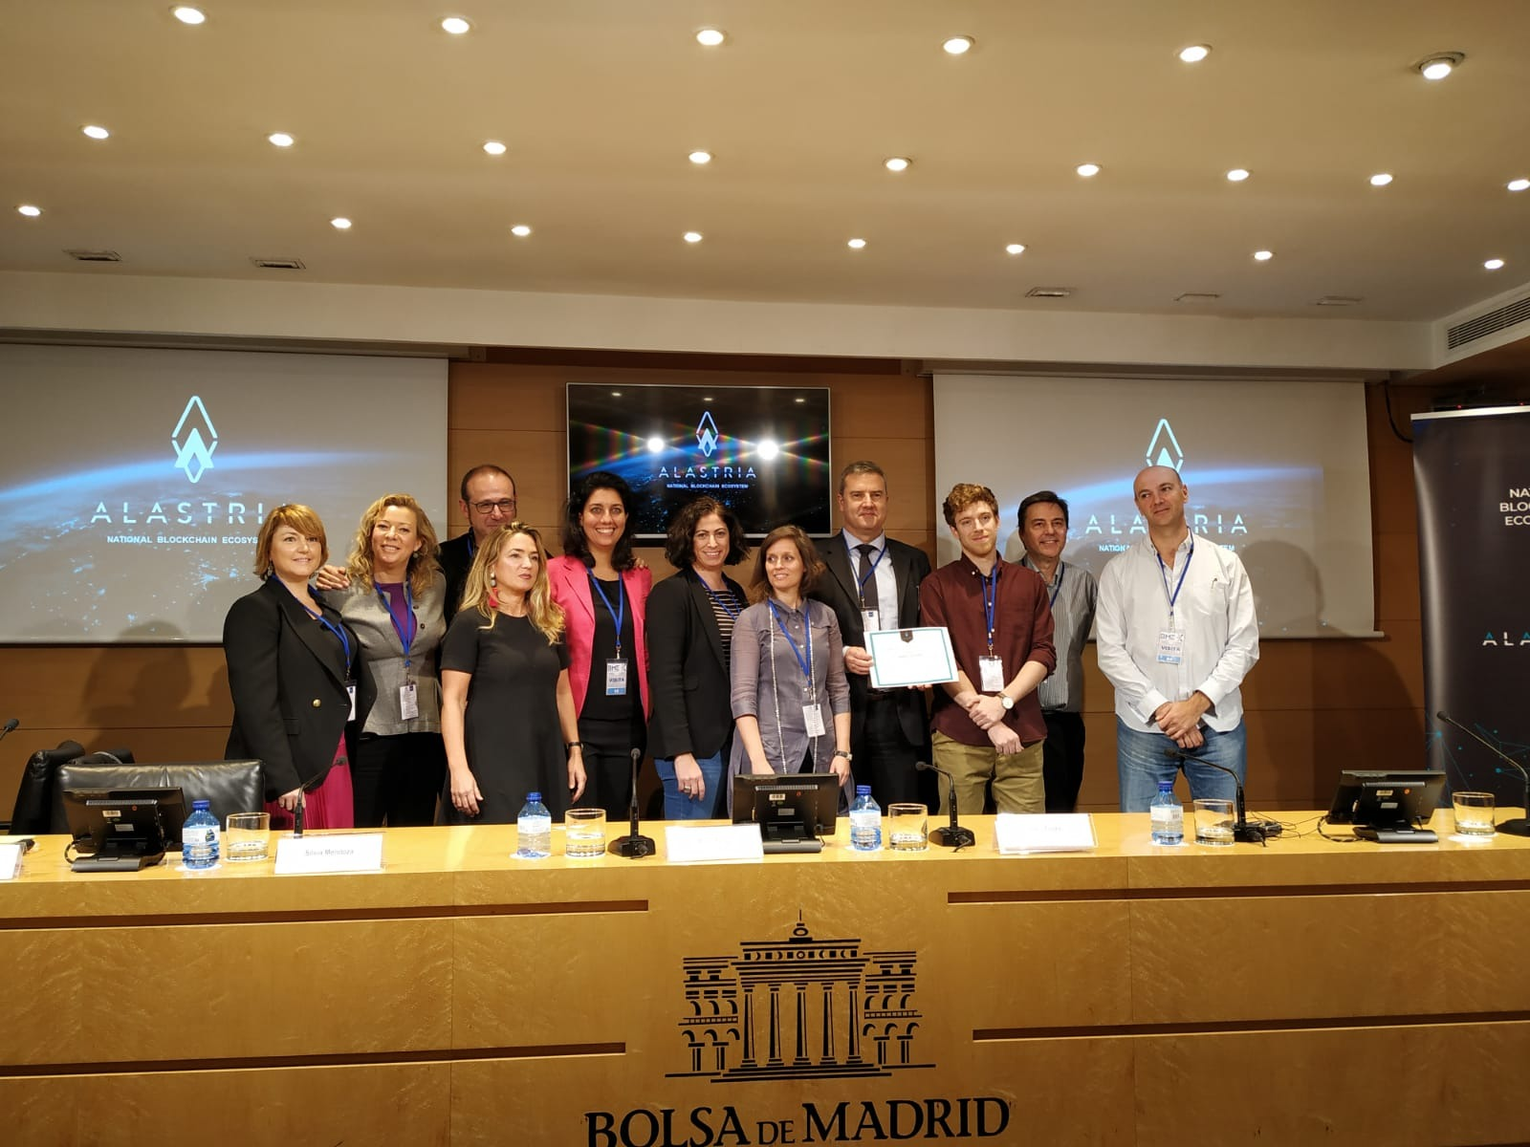
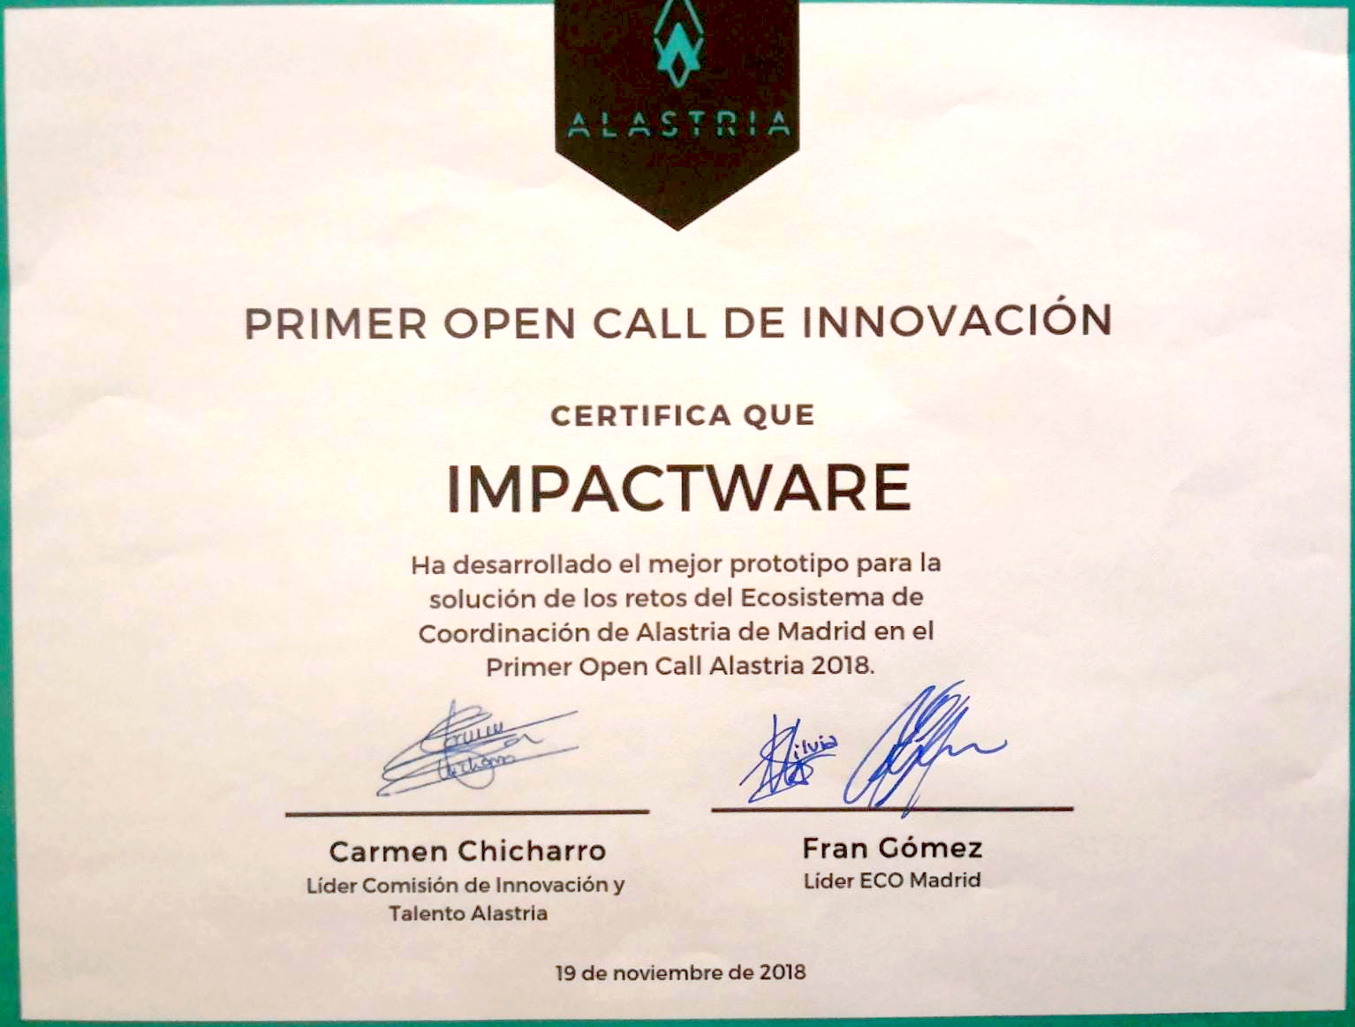
OPEN CALL de INNOVACIÓN Award
Not only in the area of ​​Occupational Risk Prevention are we leaders
These recognitions give us oxygen to continue researching in the areas of knowledge, to improve the quality of life for all citizens.
PAGE 52
PAGE 53

Slide 26
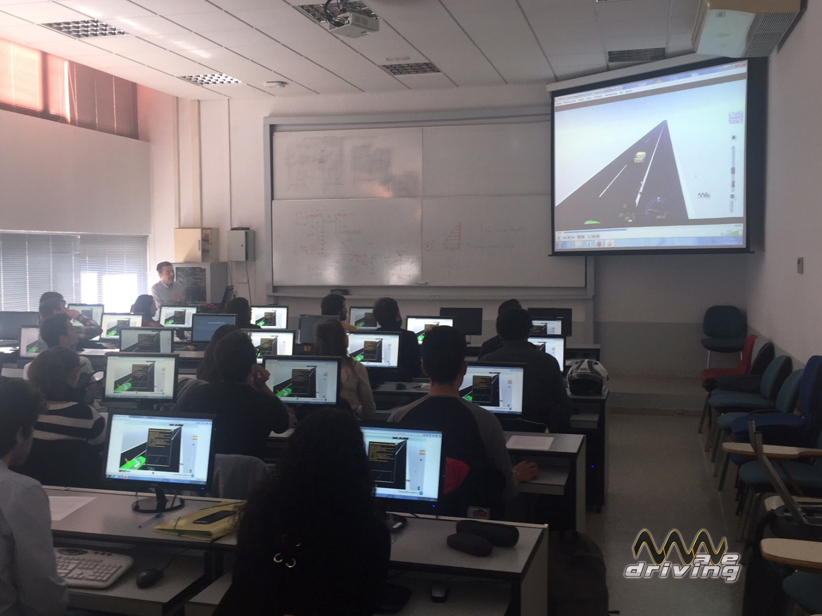
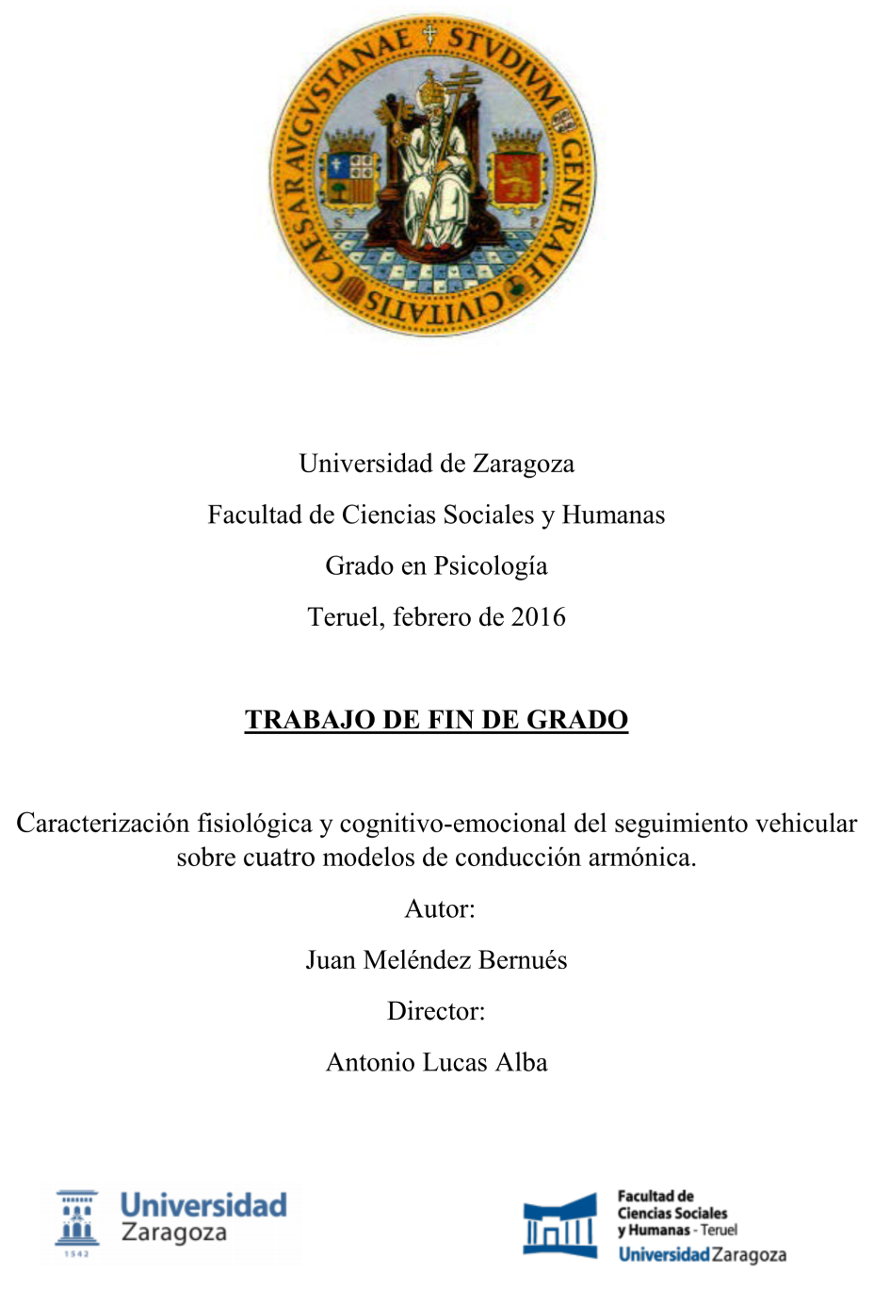
Learning Assessment.
Escuela Técnica Superior de Ingenieros de Caminos, Canales y Puertos de Madrid.
Final Degree Project
Different Bachelor's Degree Final Projects at different universities.
PAGE 54
PAGE 55

Slide 27
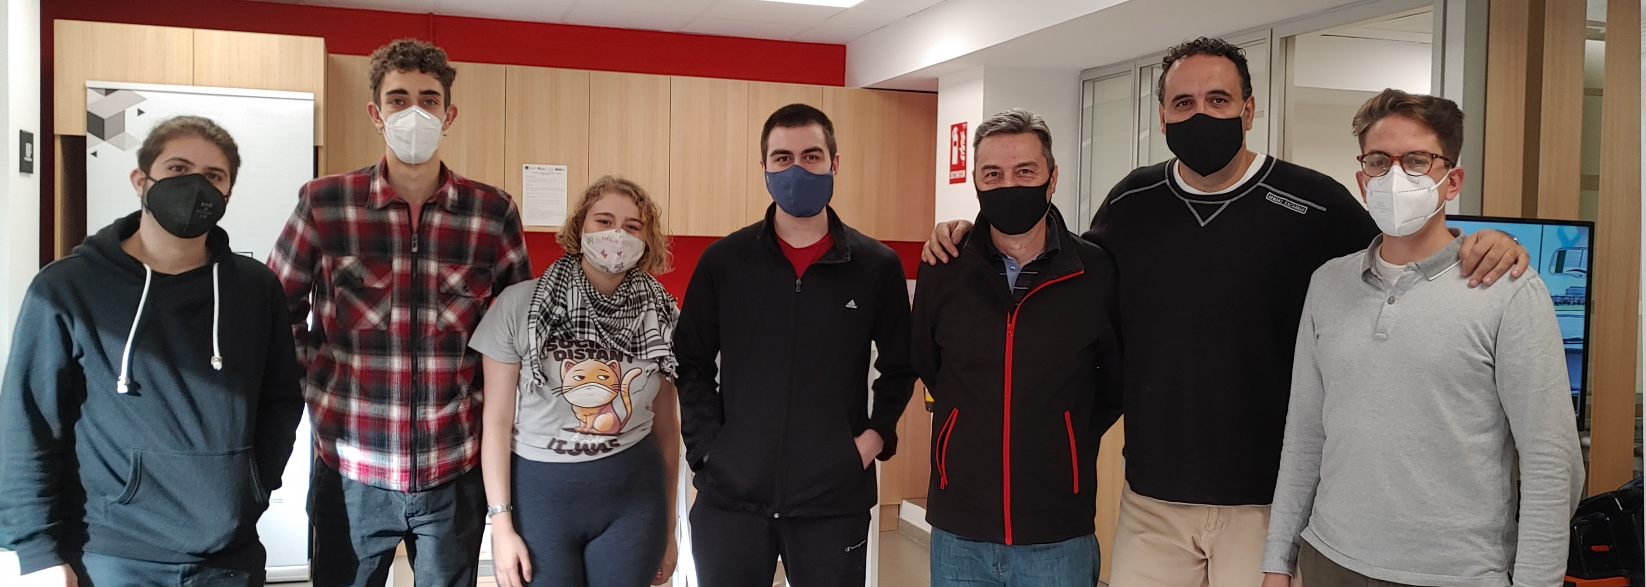
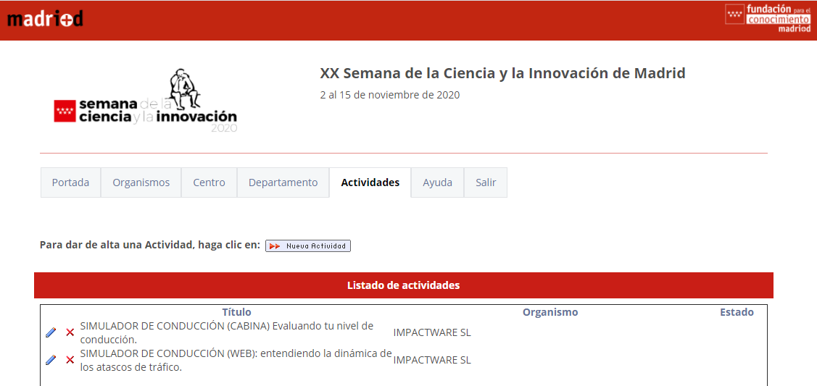
The Science and Innovation Week of the Community of Madrid. Our work is not only recognized, but also shared, completely free of charge, at annual public events.
Collaboration
We provide training, also free of charge, to students aged between 18 and 22 from different schools, in areas such as video game programming, web page design, market forecasting, etc.
PAGE 56
PAGE 57

Slide 28
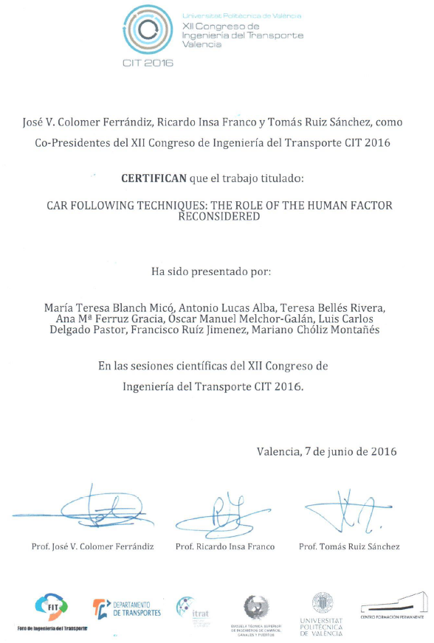
Congresses
PAGE 58
PAGE 59

Slide 29
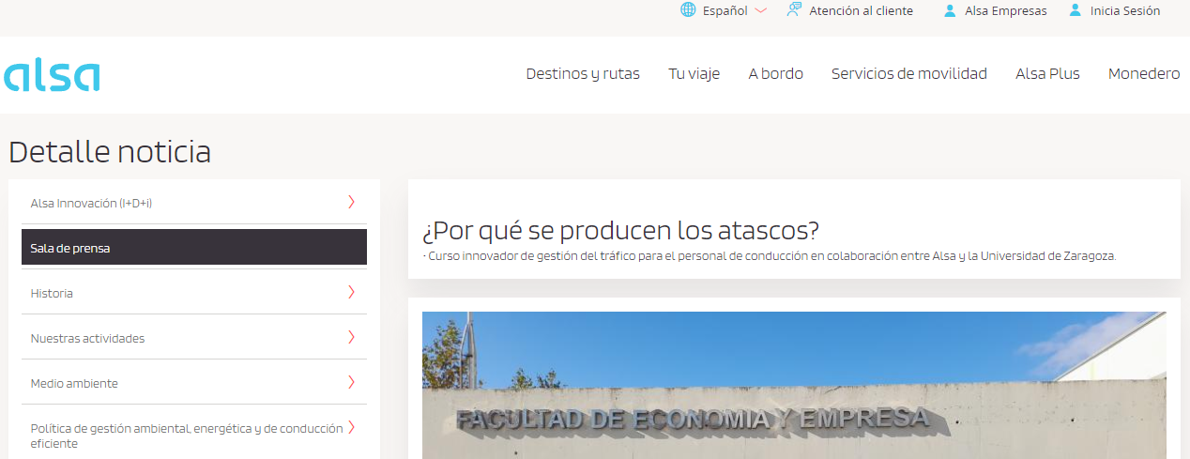
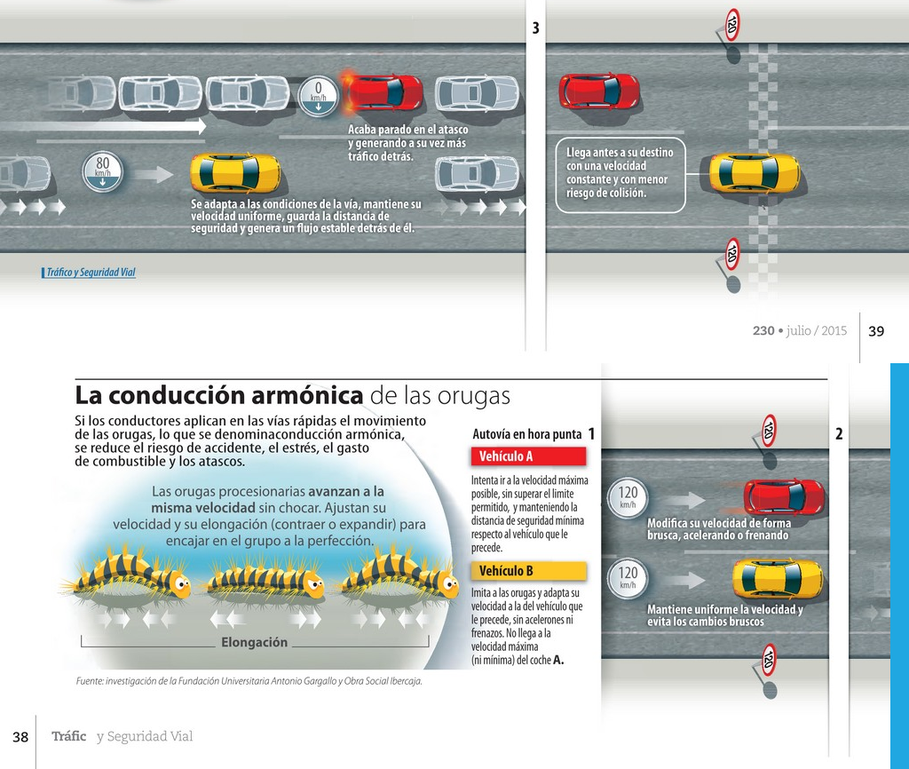
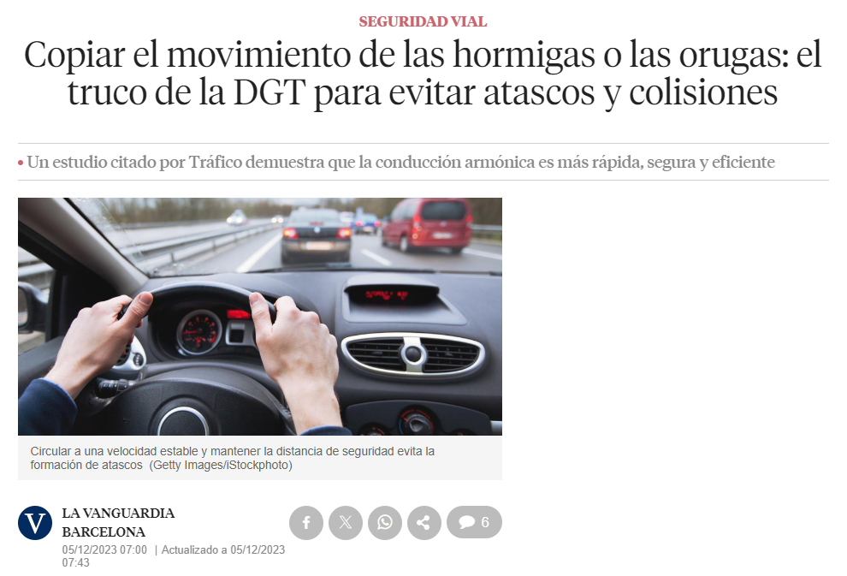
https://revista.dgt.es/es/multimedia/infografia/2015/0915La-conduccion-armonica-de-las-orugas.shtml
Press
https://www.alsa.es/-/por-que-se-producen-los-atascos
PAGE 60
PAGE 61
https://revista.dgt.es/es/multimedia/infografia/2015/0915La-conduccion-armonica-de-las-orugas.shtml
https://www.lavanguardia.com/motor/dgt/20231205/9415848/copiar-movimiento-hormigas-orugas-truco-dgt-evitar-atascos-colisiones-tsc.html

Slide 30
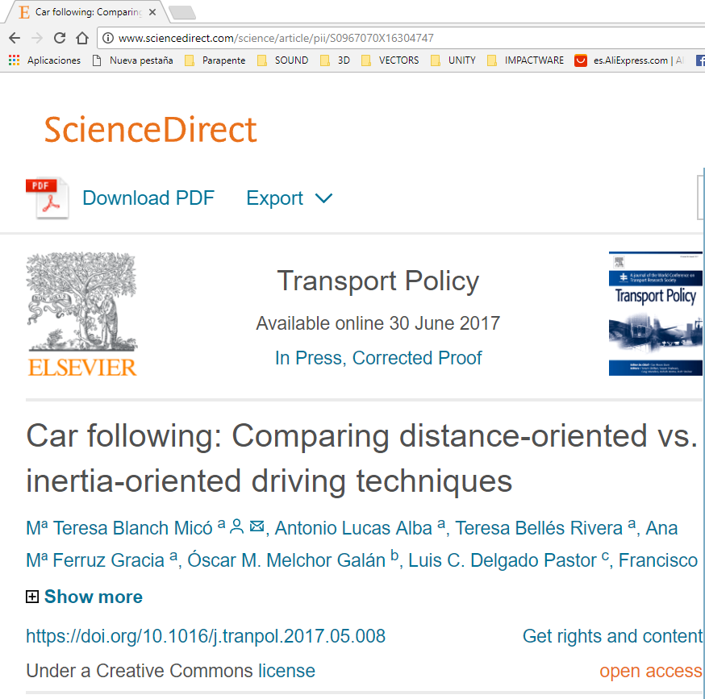
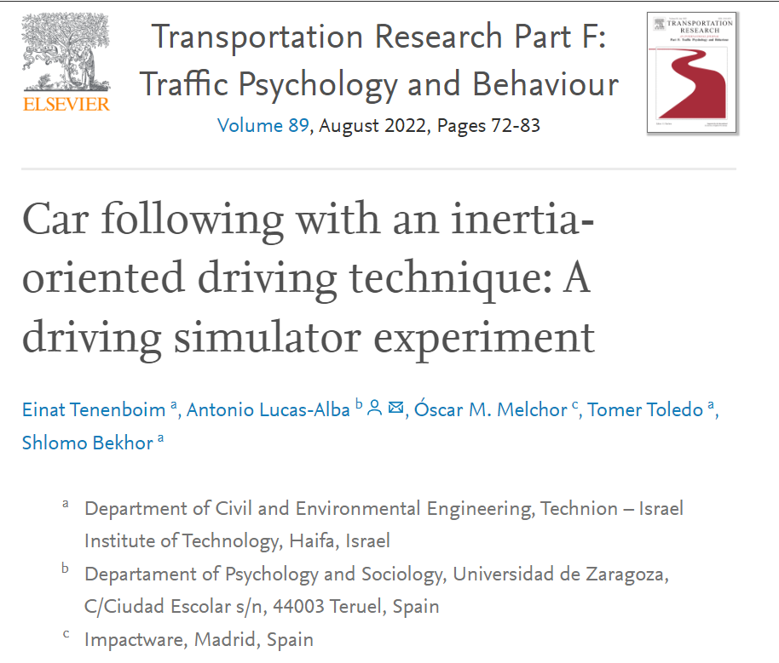
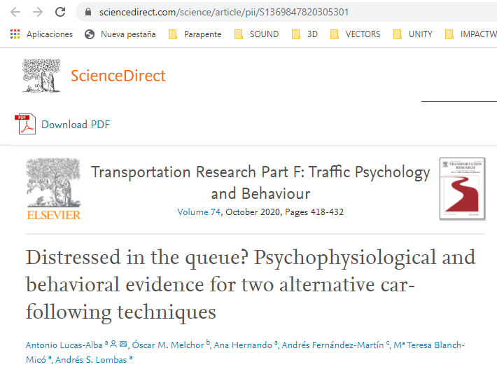
Scientific Papers
Multiple Scientific articles published.
COVID-19.
During the pandemic, the Technion (Israel) conducted a new scientific study, this time adapting its own simulators, and the results were once again conclusive.
PAGE 62
PAGE 63

Slide 31
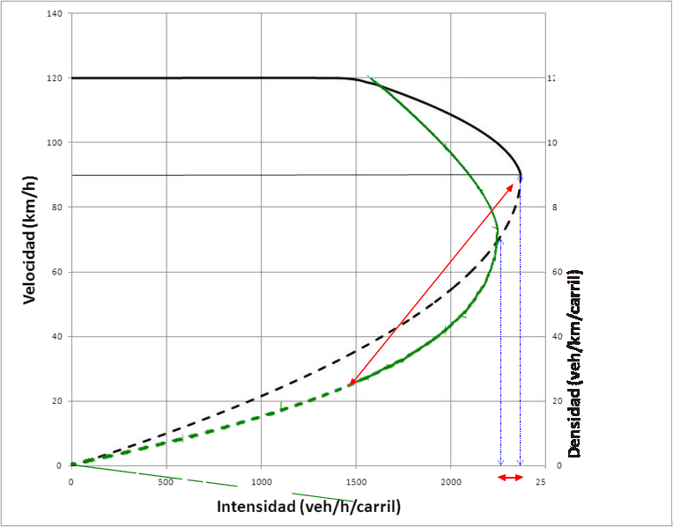
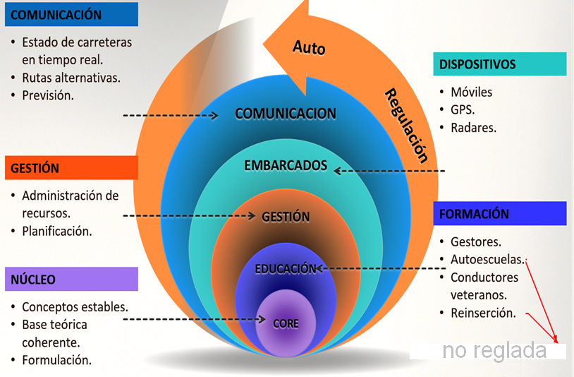
Traffic Engineering
Sustainability
Modification of Traffic Flows:
Reducing travel times,
Controlling Pollutant Emissions,
Optimizing Infrastructure Utilization.
It's not just training; WD represents a comprehensive technological solution to the world of Mobility and Sustainability since it can be integrated into technological systems
both onboard and otherwise,
in Collective Traffic Control (Management Centers).
PAGE 64
PAGE 65

Slide 32
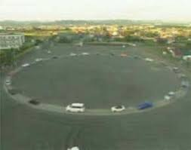
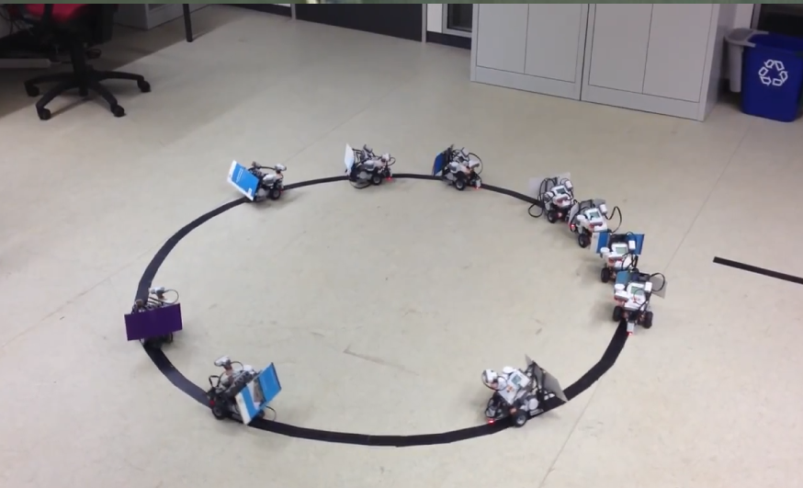
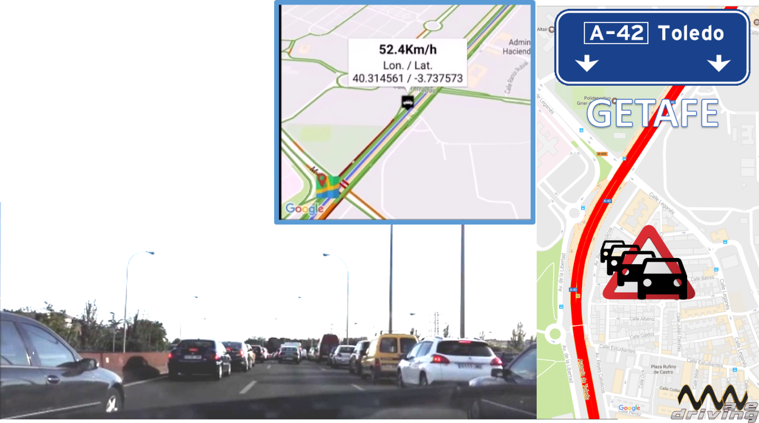
Clearing a real traffic jam
It was enough to modify the behavior of a single driver to solve a real traffic jam on the A-42 Madrid-Toledo highway, in the central lane.
With two other drivers, one on the left and one on the right, practicing inertial driving, this traffic jam would have been solved... for 15 minutes.
More inertial drivers are needed.
By modifying algorithms in small-scale models (Arduinos) in the laboratory, we were able to learn before transitioning to the real world (Experiment at Nagoya University).
PAGE 66
PAGE 67

Slide 33
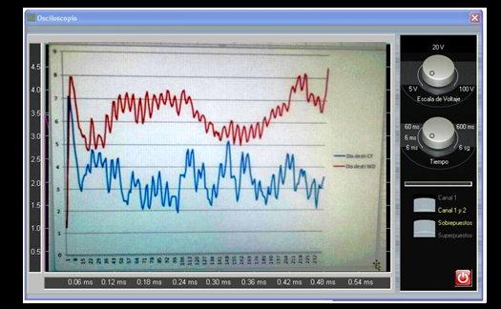
Emotions
It has been proven that understanding traffic dynamics reduces levels of stress and anxiety behind the wheel by between 20 and 80%.
The following have been measured:
Skin Conductance
Heart Rate
Respiratory Rate
Face Temperature
PAGE 78
PAGE 69

Slide 34
Thanks
Finally, we believe that the 6-Electro-Car-Diagrams will be mandatory elements in driver training in the coming years not only in Europe, but worldwide.
Here we only present a brief summary of years of work in the hope that a new traffic engineering will emerge, with new concepts and new challenges.
We want to thank you for all the attention you have given us, and to let you know that we are at your disposal for any questions or doubts you may have.
Óscar Melchor Galán
Antonio Lucas Alba
contact@wavedriving.online
PAGE 70

Slide 35
Atributes: -
https://www.vecteezy.com
https://pngtree.com
https://www.pexels.com
https://unsplash.com

