Slide 1
Photo Album 2018-2023

Slide 2
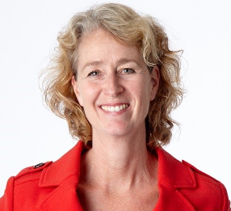
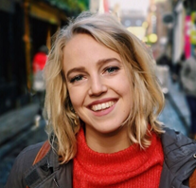
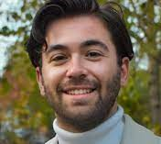
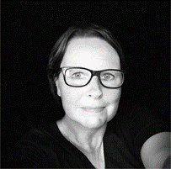
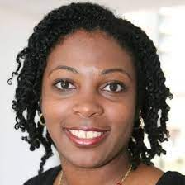
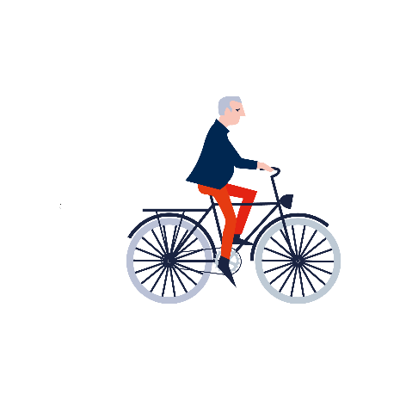
Voorstellen in de chat
Team Doortrappen
Juul Sonja Tom
Jacqueline Cherryl

Slide 3
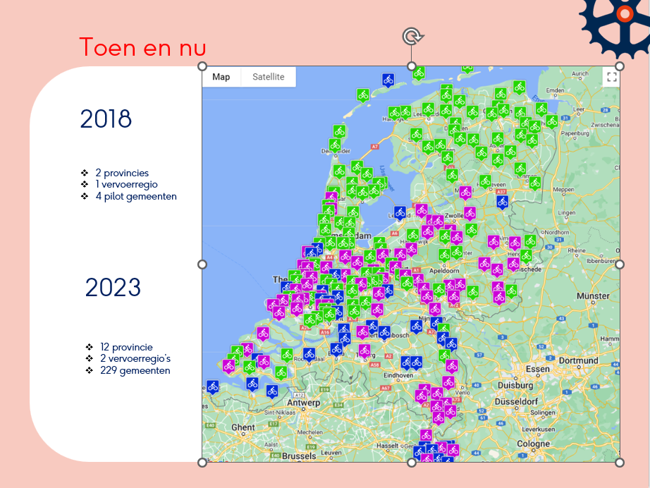
Voorstellen in de chat
Toen en nu
2018
2 provincies
1 vervoerregio
4 pilot gemeenten
2023
12 provincie
2 vervoerregio’s
223 gemeenten

Slide 4
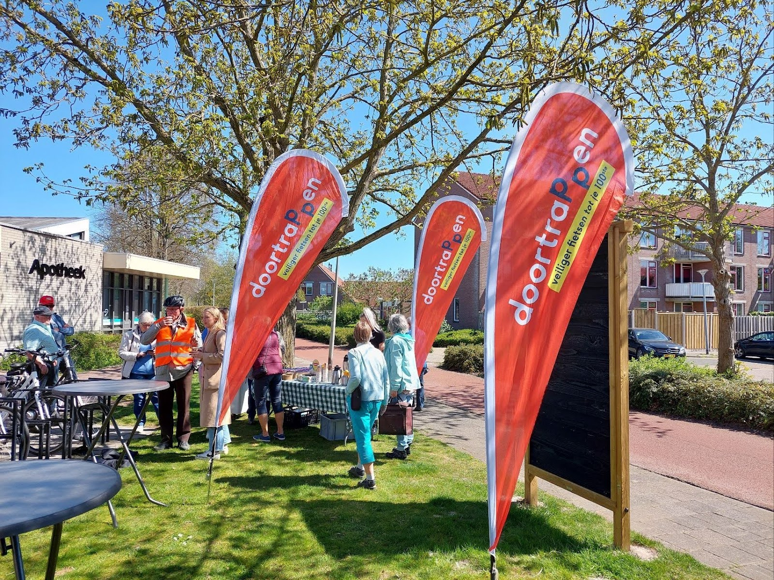
Voorstellen in de chat
Notes:
1. Recognizability and repetition

Slide 5
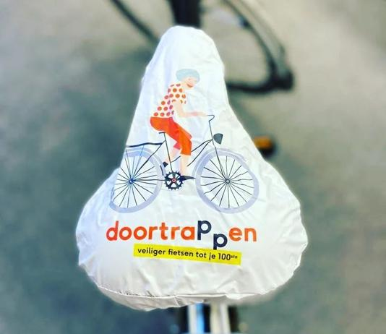
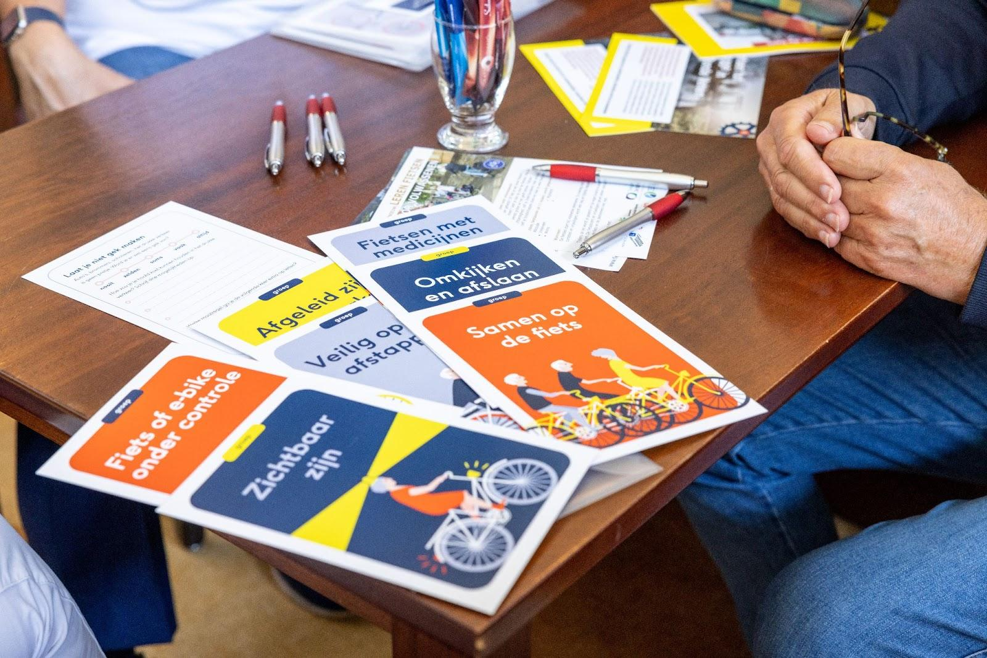

Slide 6
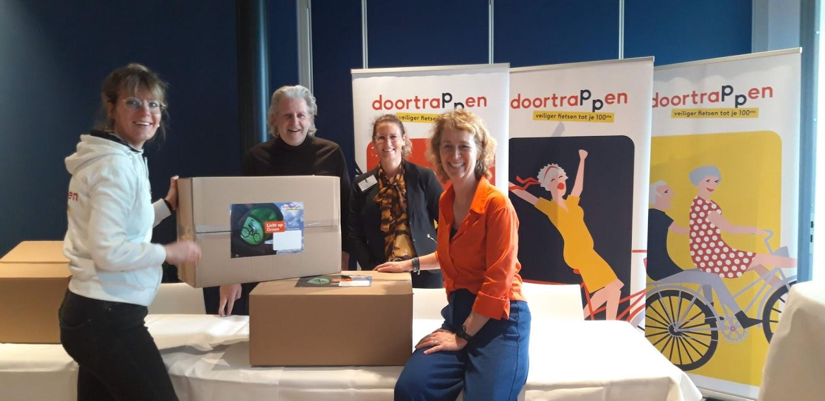
Voorstellen in de chat
Notes:
Launch of starter package for starting municipality 'green light for municipality ...'

Slide 7
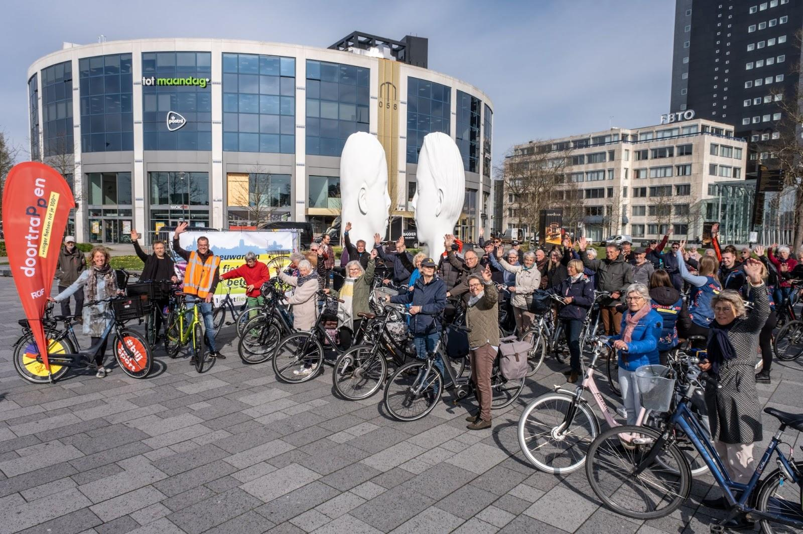
Voorstellen in de chat
Notes:
2. From and by us

Slide 8
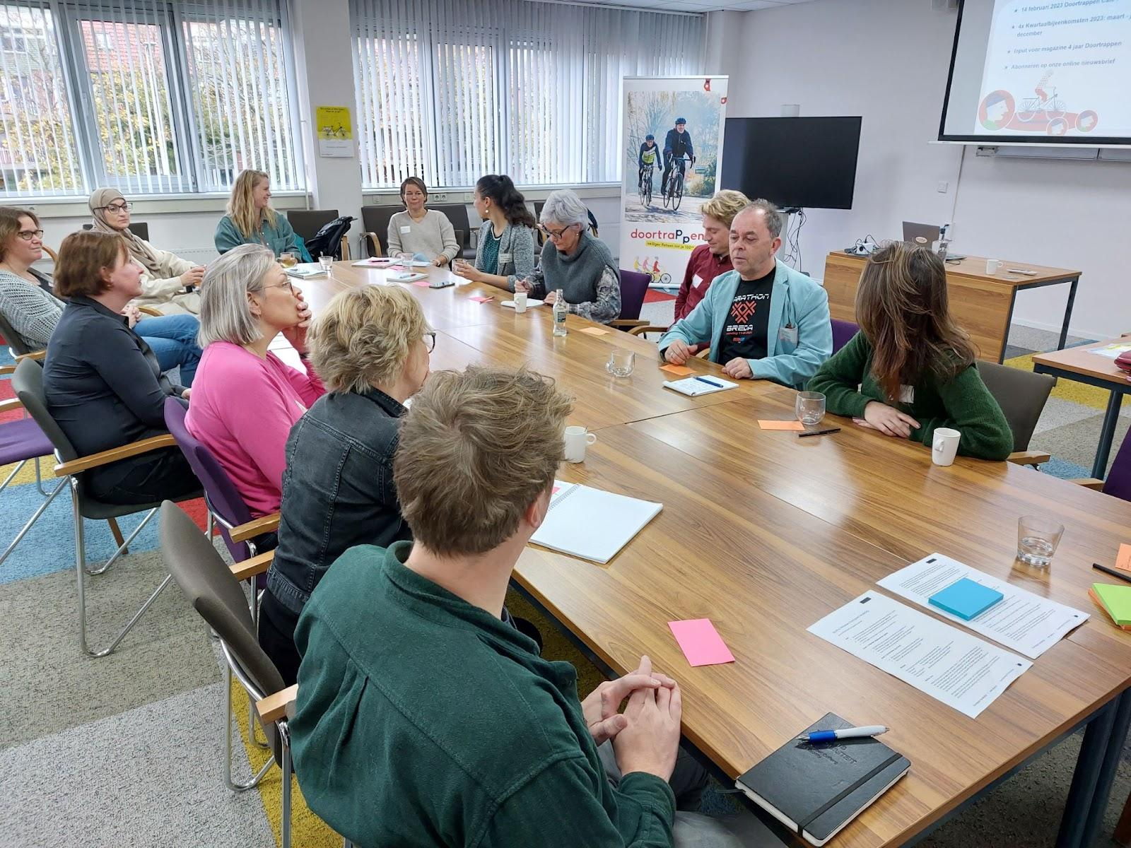
Voorstellen in de chat
Notes:
The CycleOn Quartermakers (provinces)

Slide 9
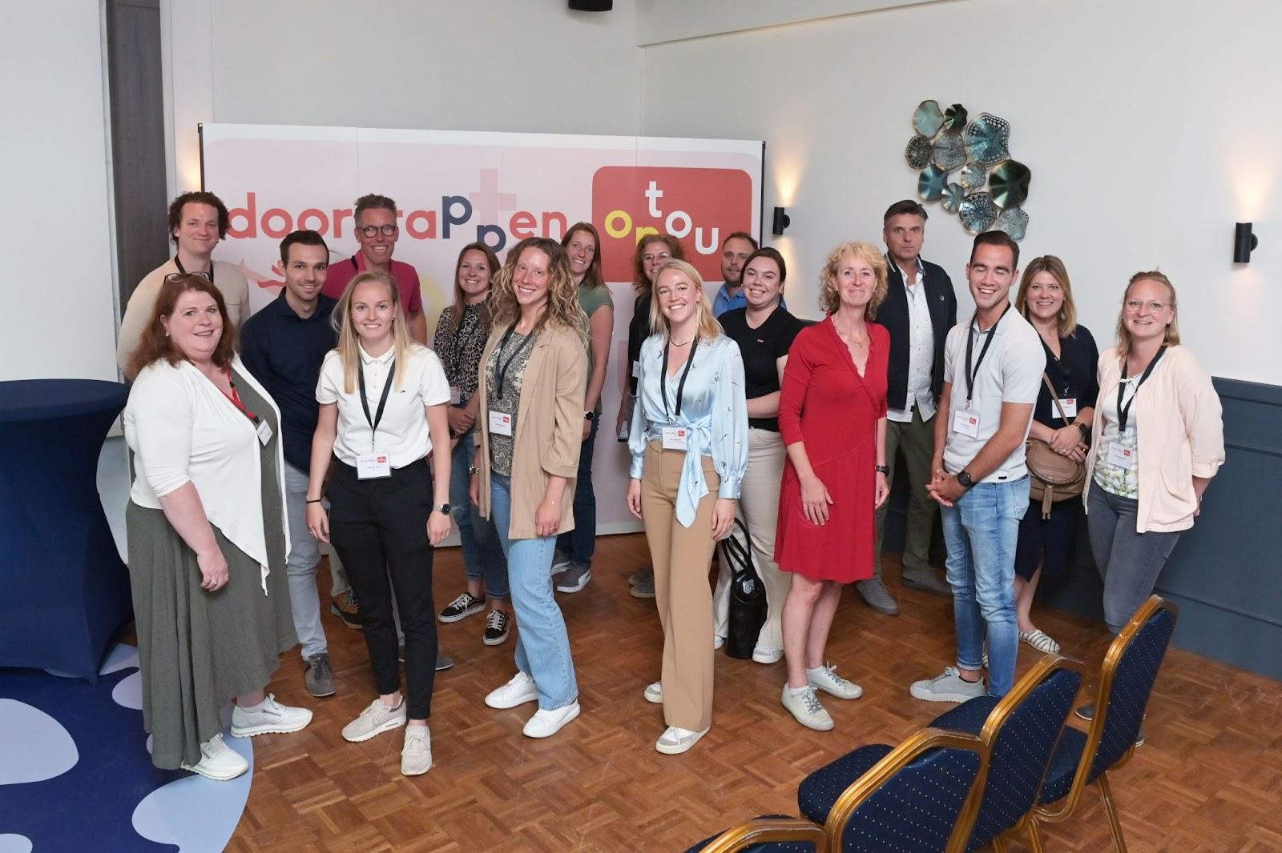
Voorstellen in de chat

Slide 10
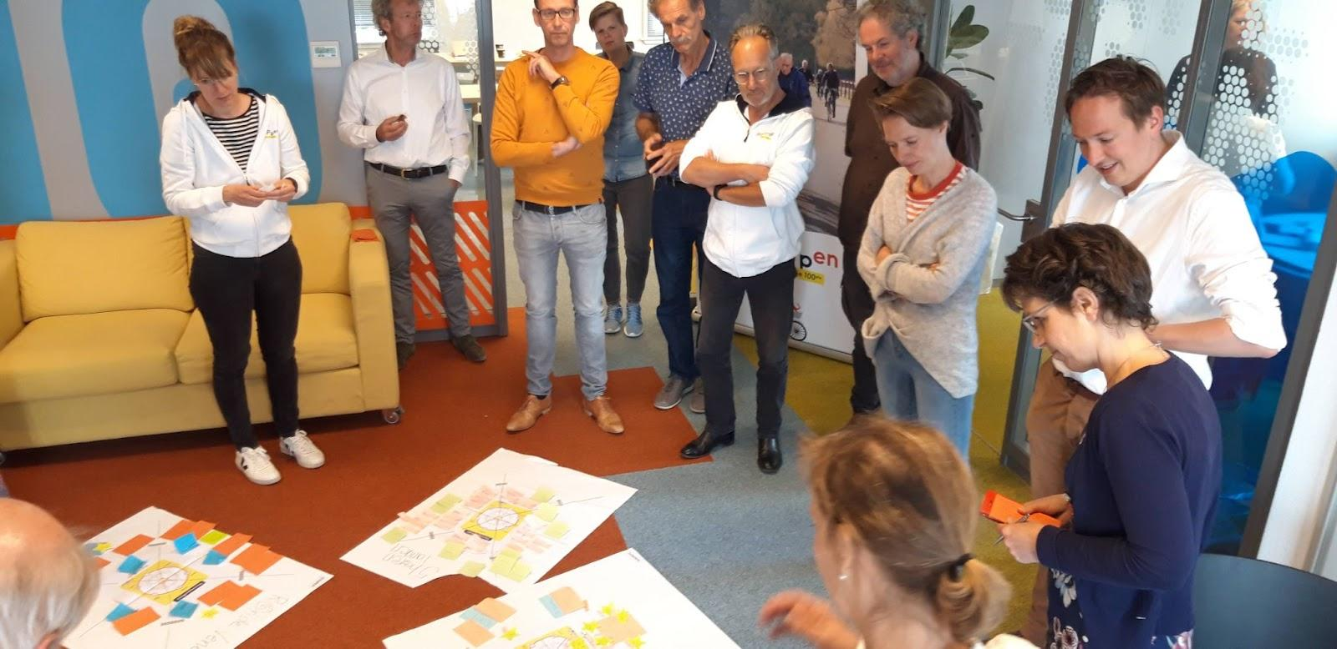
Voorstellen in de chat

Slide 11
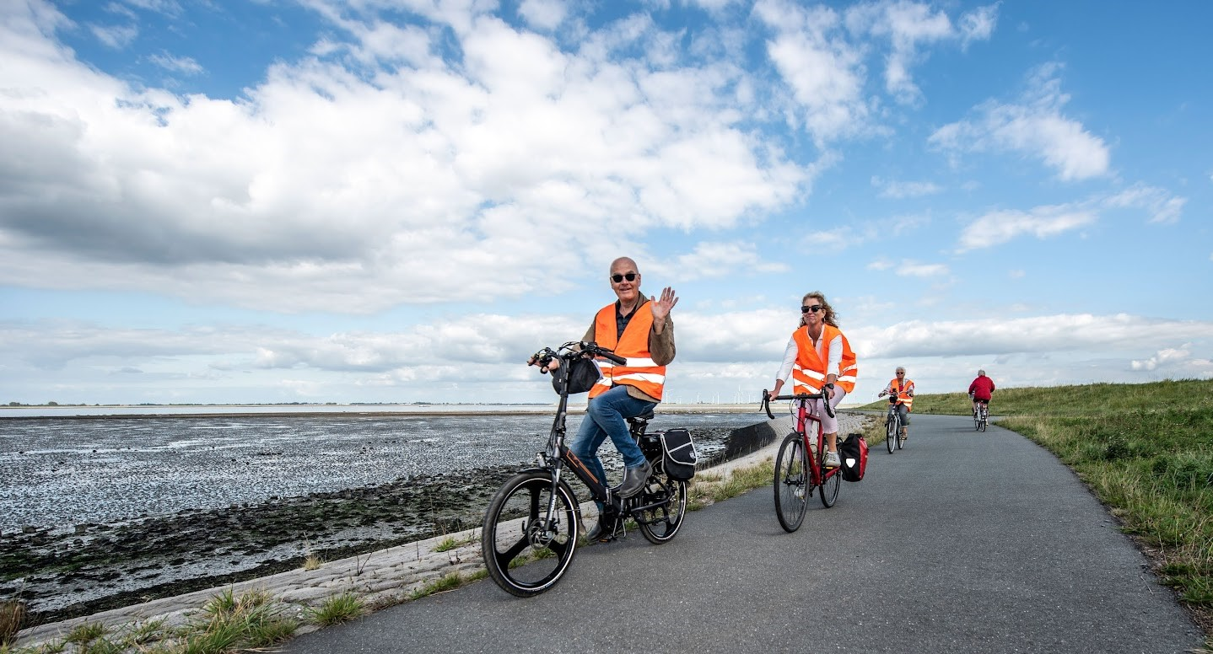
Voorstellen in de chat
Notes:
3.Link sport and exercise to traffic and transport

Slide 12
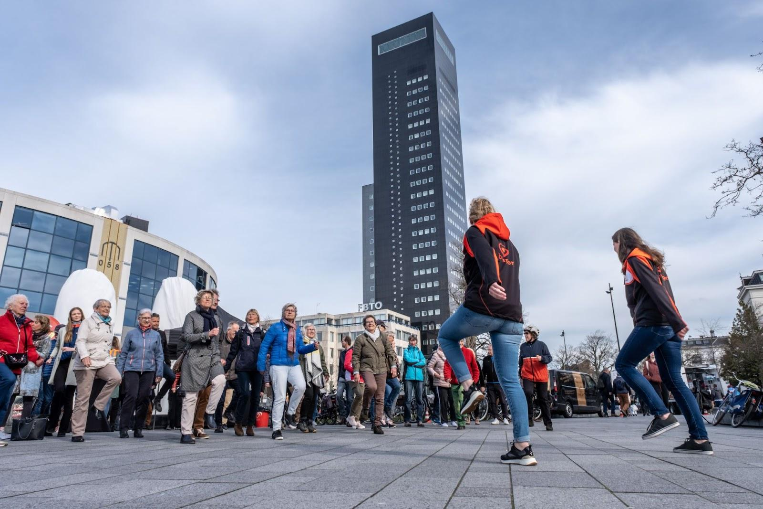
Voorstellen in de chat
Notes:
The role of the community coach in the municipality

Slide 13
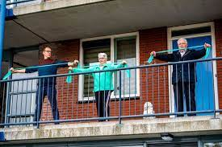
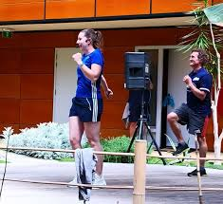
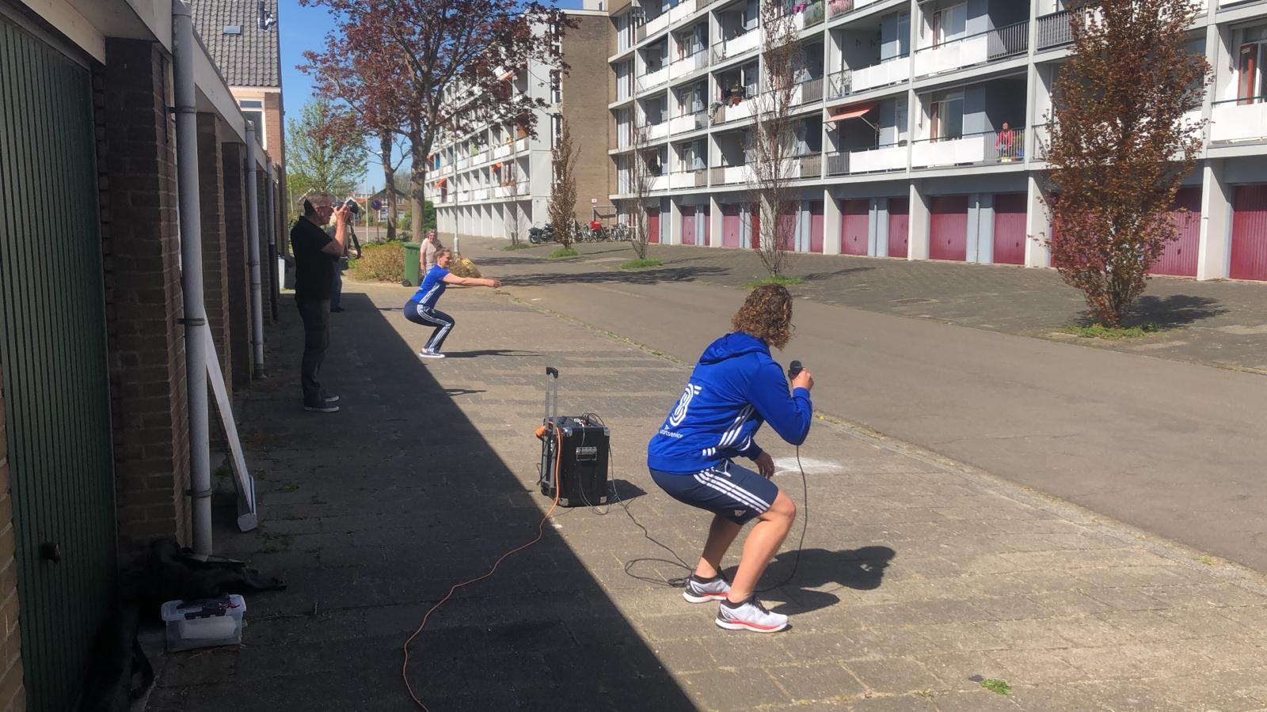
Notes:
balcony gym during corona pandemic

Slide 14
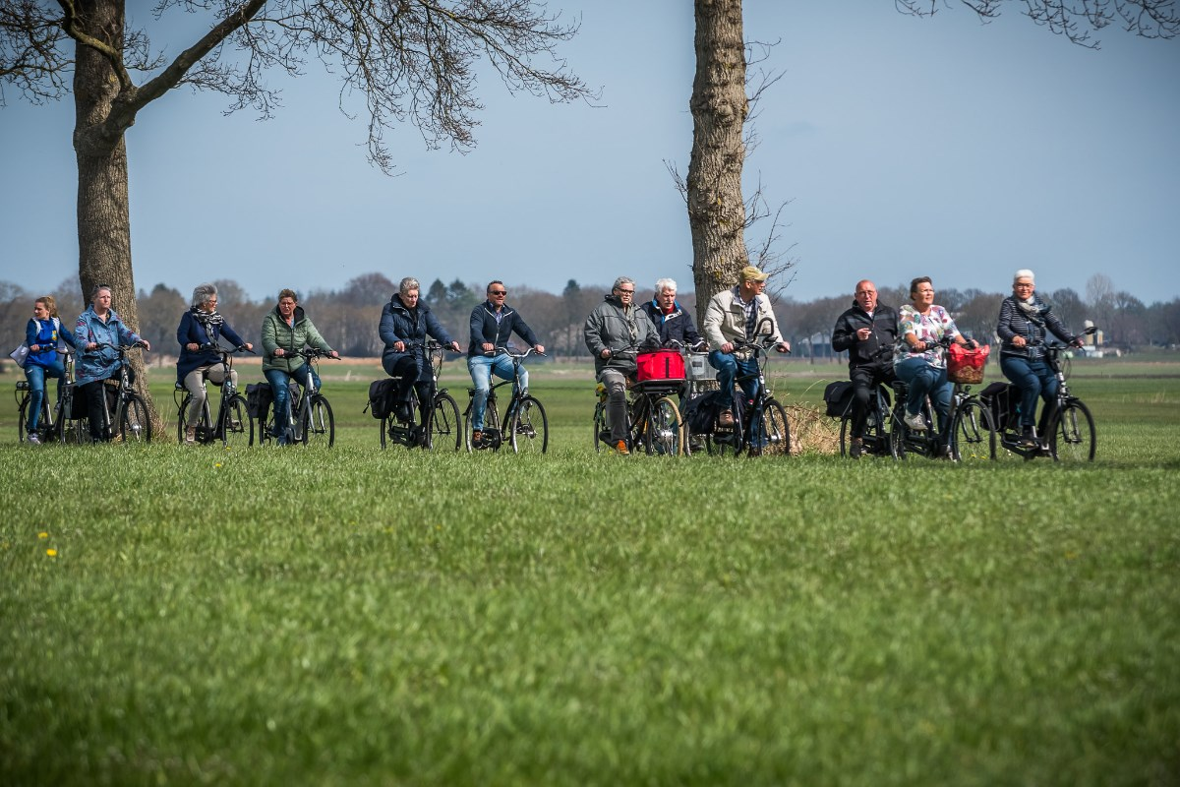
Voorstellen in de chat
Notes:
means much more than just cycling: together; social, against loneliness, health

Slide 15
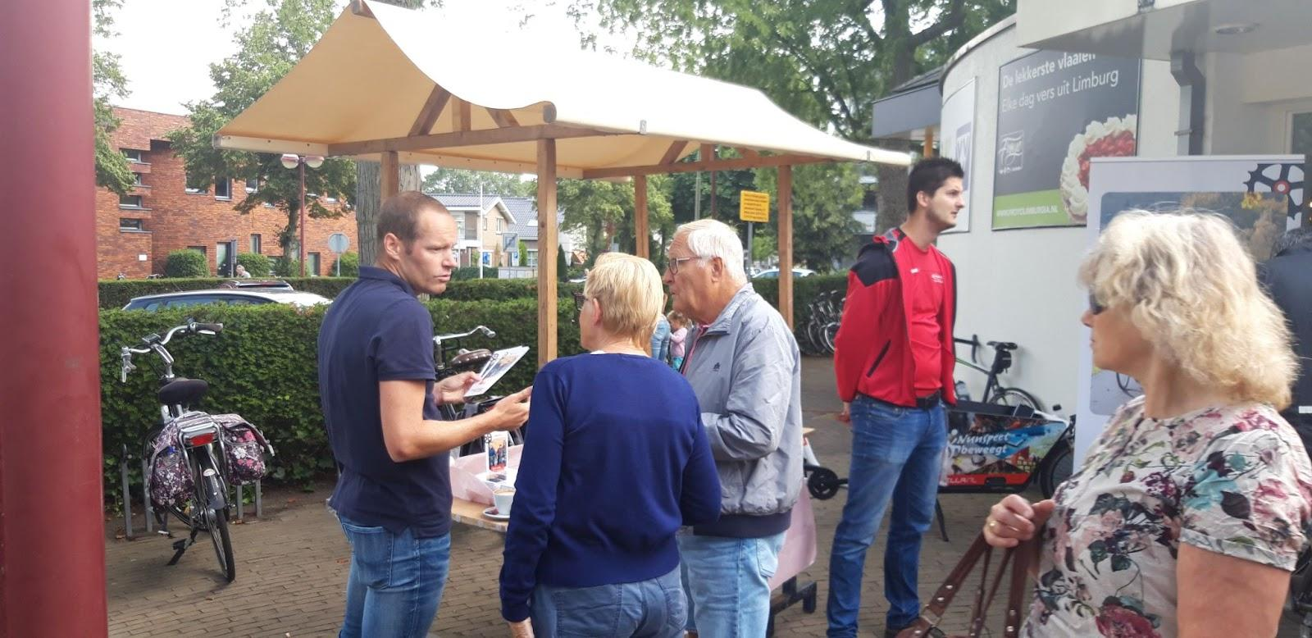
Voorstellen in de chat
Notes:
present at several events

Slide 16
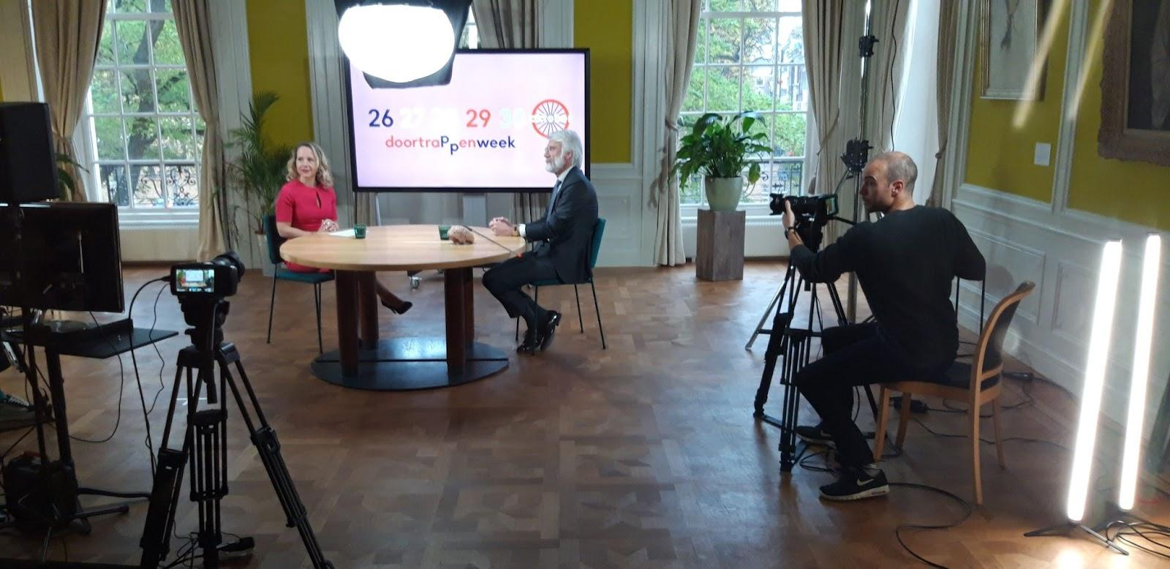
Voorstellen in de chat
Notes:
Webinar week Oct2020.
Professor Scherder about continuing to cycle - exercise - brain health. neuroscientist.

Slide 17
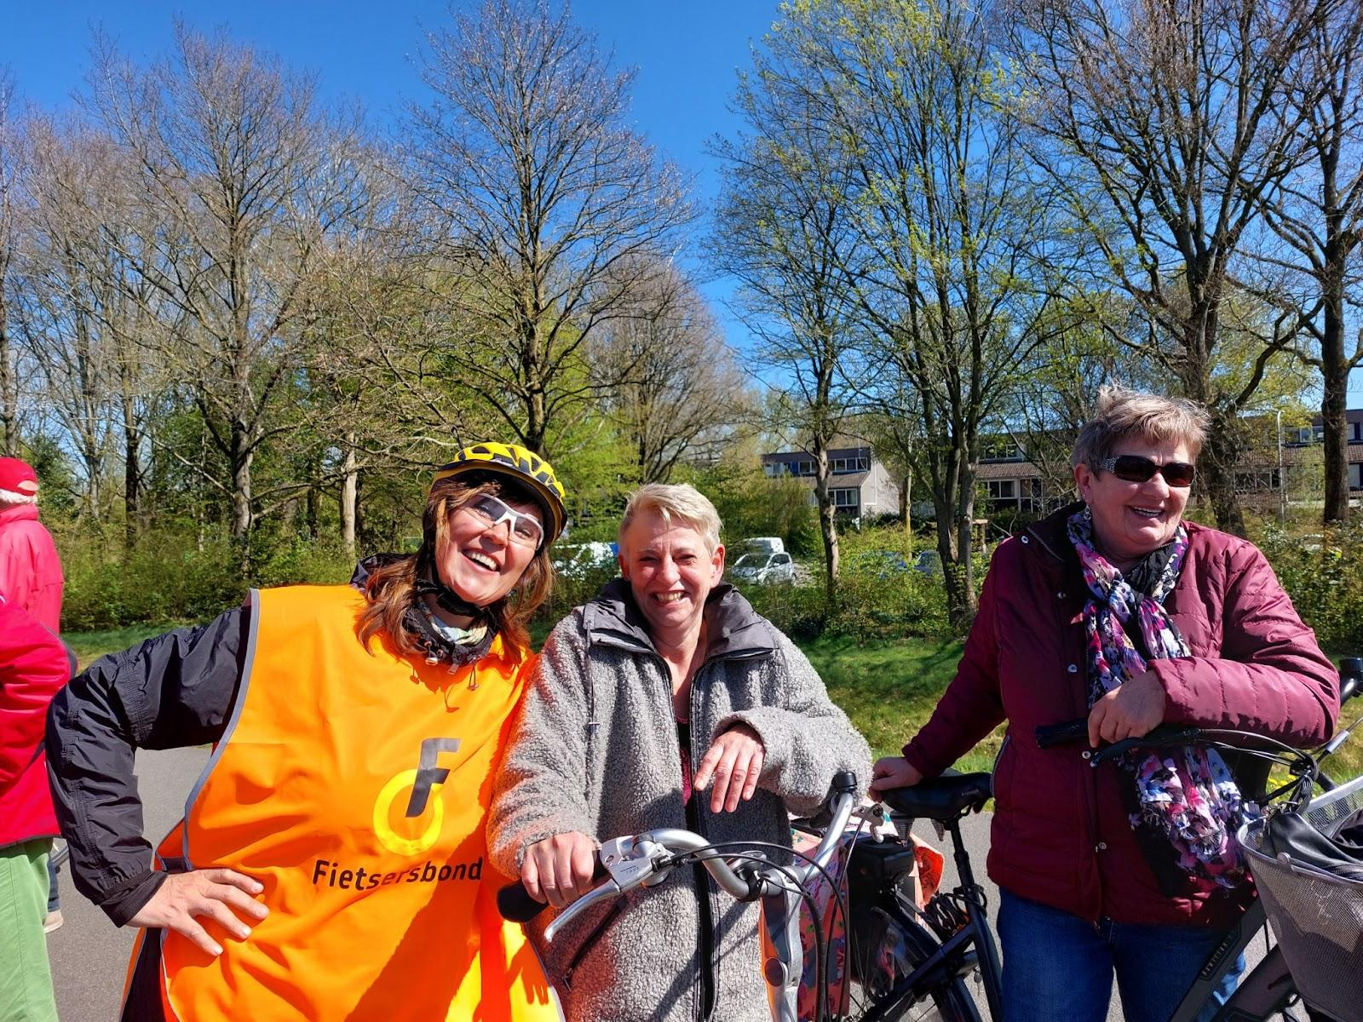
Voorstellen in de chat
Notes:
4. Work with local partners

Slide 18
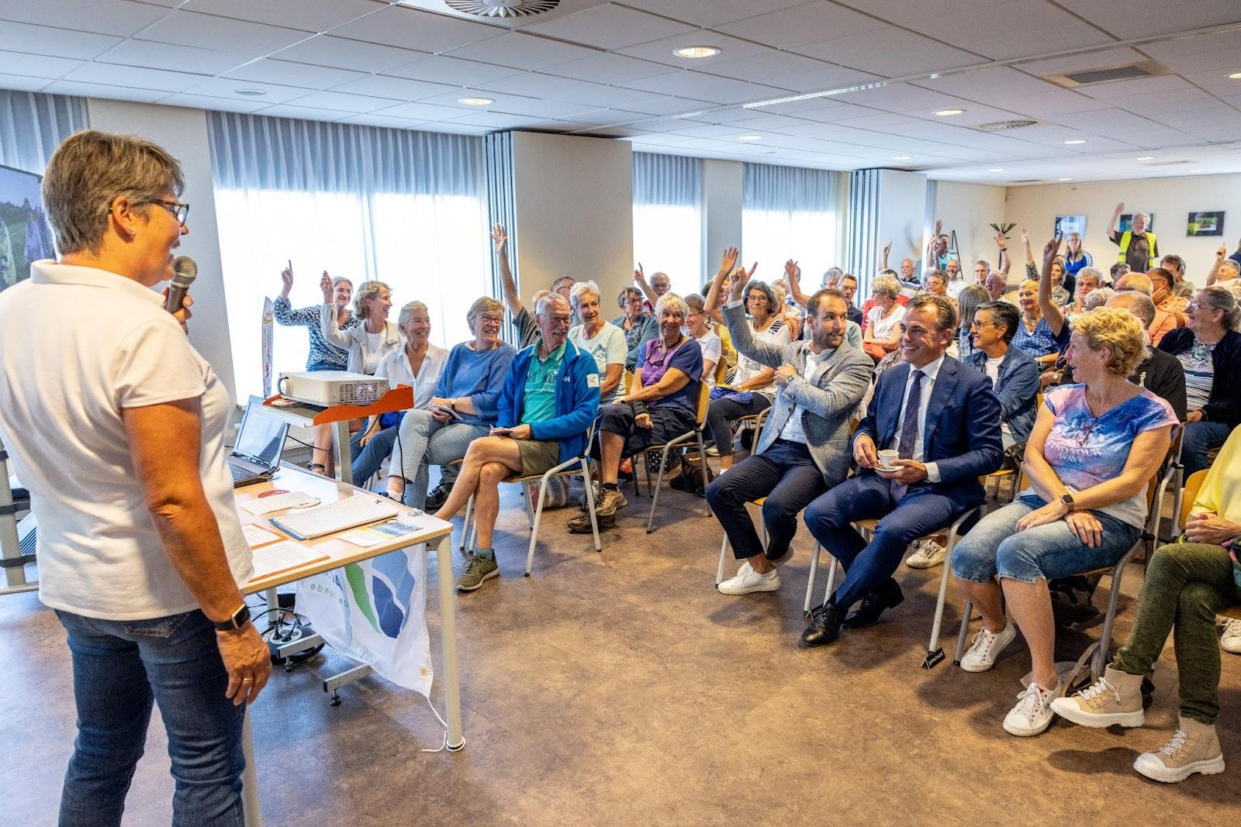
Voorstellen in de chat
Notes:
Working visit by Minister Harbers to the municipality De Ronde Venen (12 Sept. 2022)

Slide 19
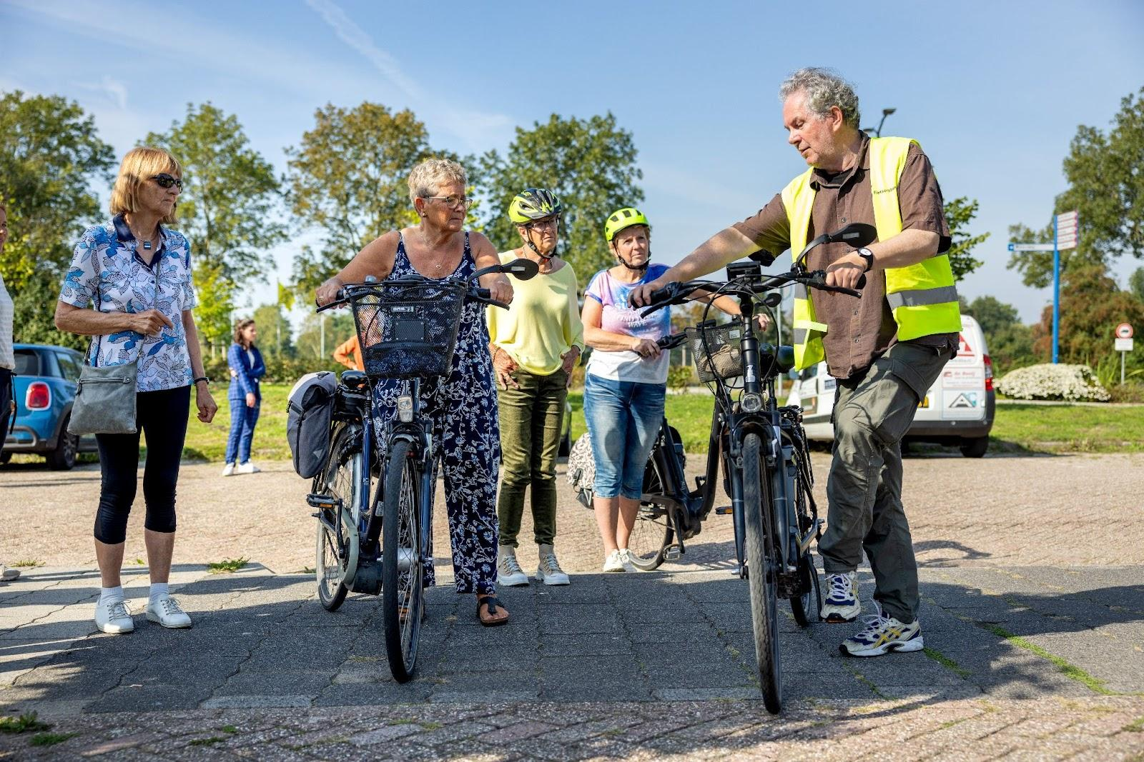
Voorstellen in de chat
Notes:
Cycling teacher

Slide 20
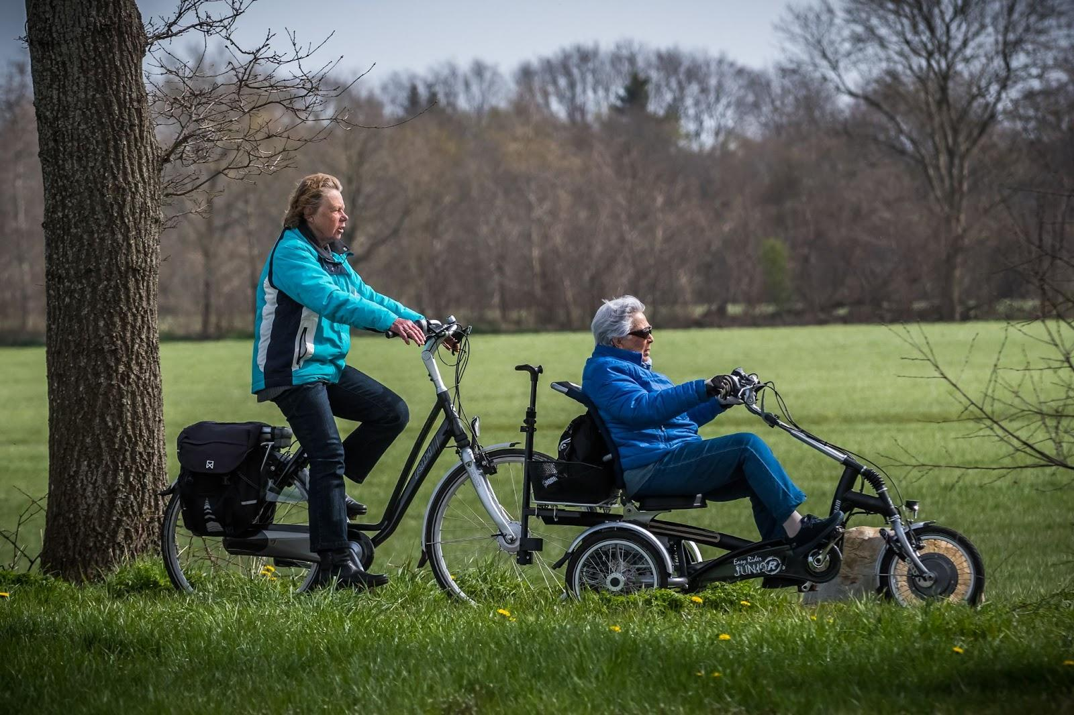
Voorstellen in de chat
Notes:
Tricycle discovery days

Slide 21
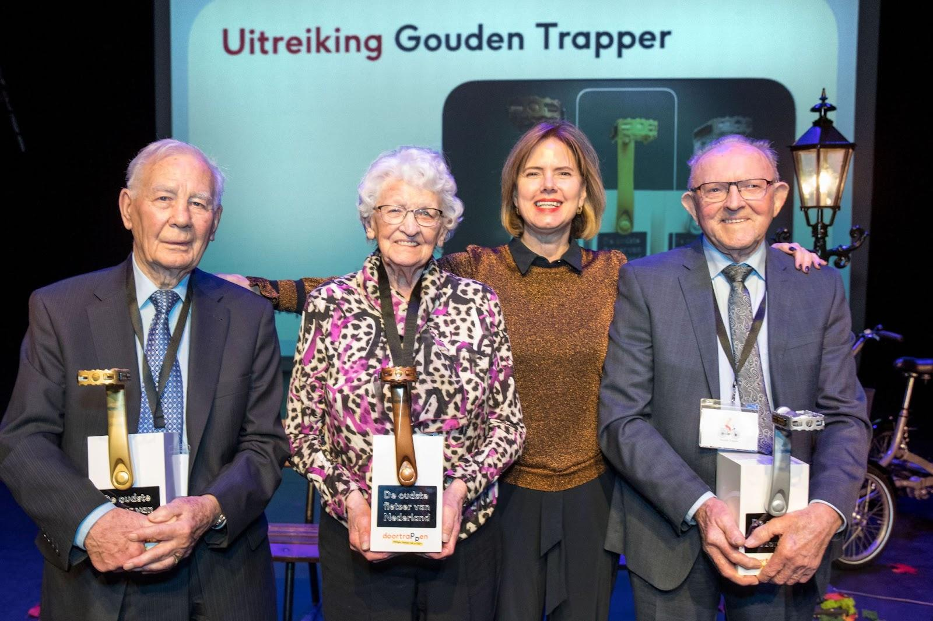
Voorstellen in de chat
Notes:
5. from unconscious to ambassador of CycleOn

Slide 22
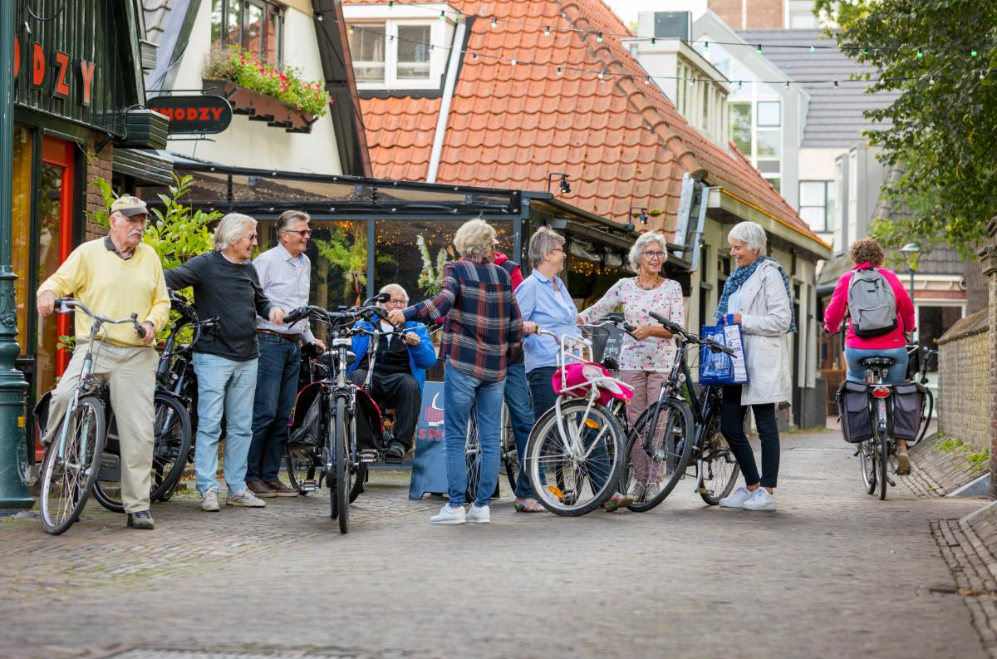
Voorstellen in de chat

Slide 23
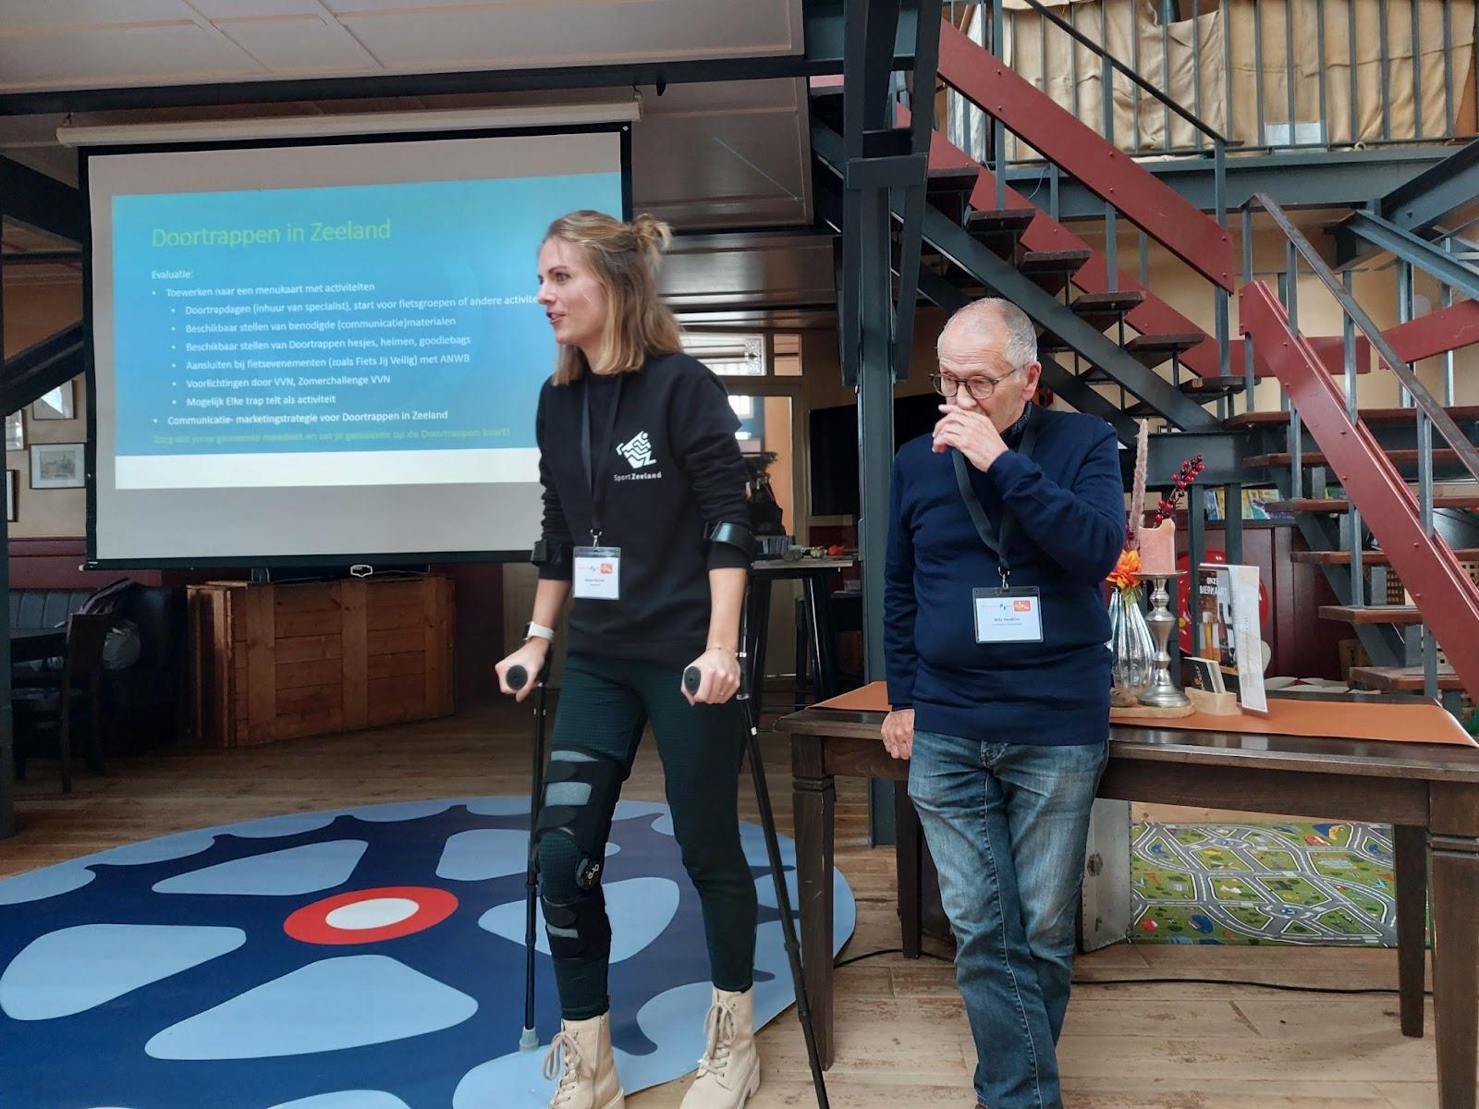
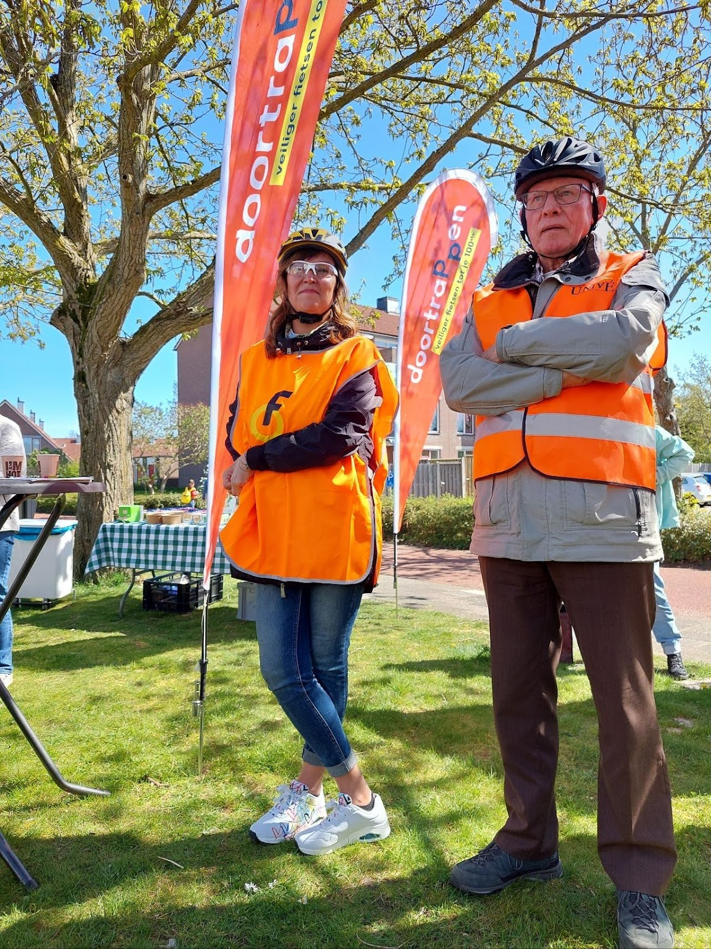
Voorstellen in de chat
Notes:
Two ambassadors of CycleOn

Slide 24
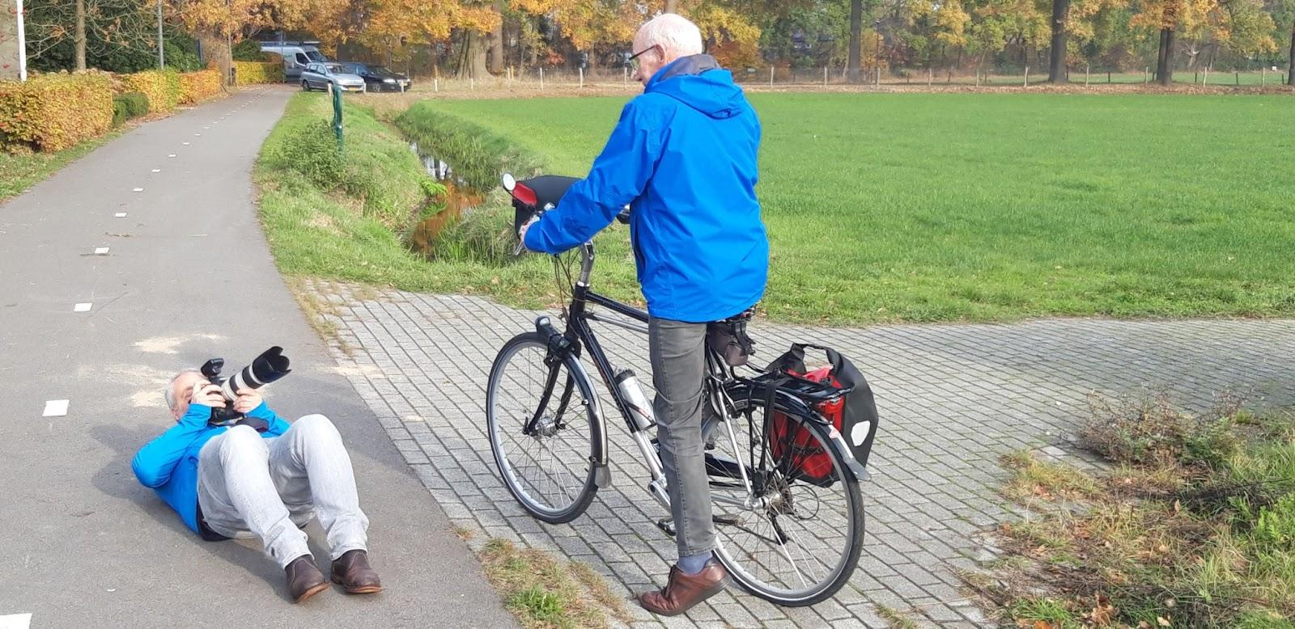
Voorstellen in de chat
Notes:
Photo shoot

Slide 25
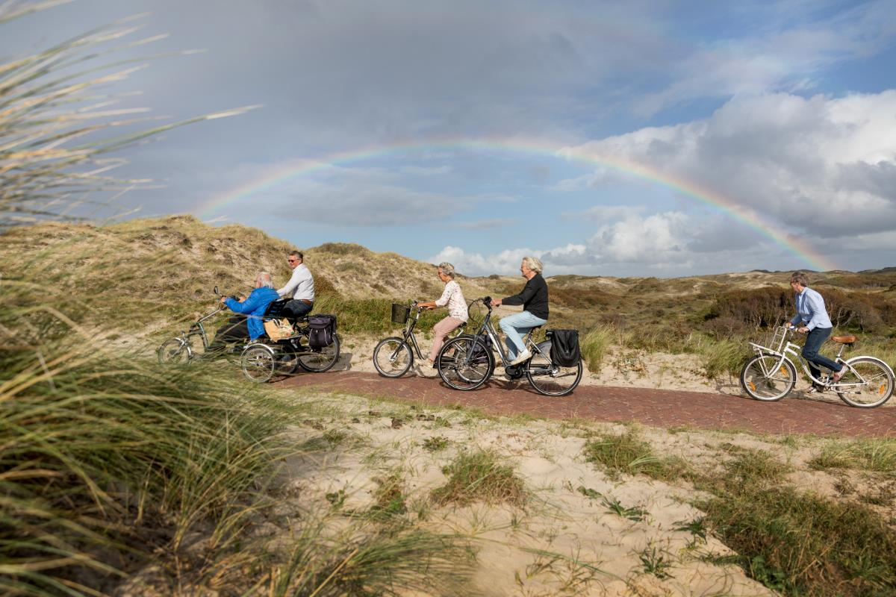
Plezier
Notes:
6. Main success factor: have fun together, enjoy!

Slide 26
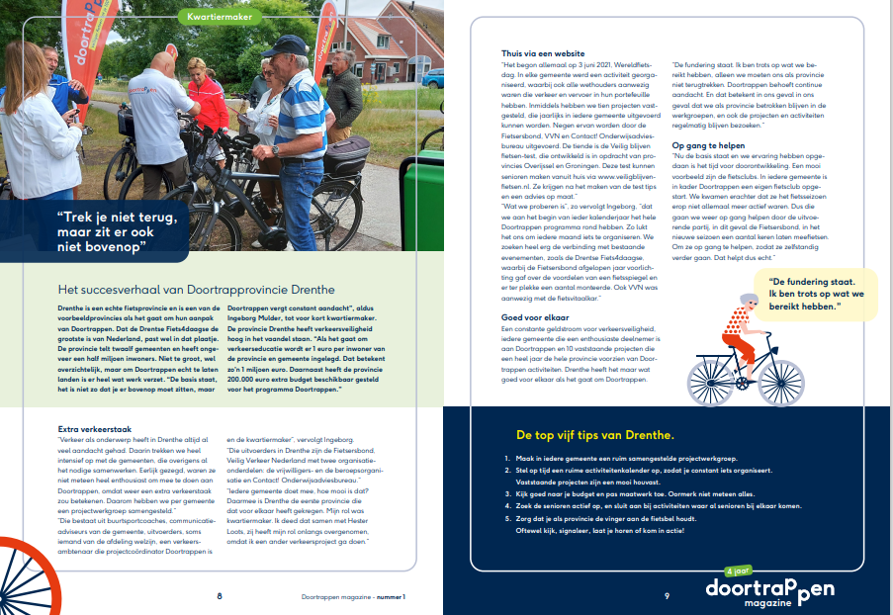
Handleiding 2.0
Notes:
CycleOn magazine (in Dutch…)

