Slide 1

11th May 2022

Slide 2
2
OBJECTIVES FOR 2022
Continue implementation in the countries where Drive Safe has been rolled-out
Roll-out Drive Safe in Europe, South Africa and Australia

Slide 3
3
PROJECT TEAM
The project team is managed from Spain
Contact the QSEs in the target countries
Focal Point of the project team is identified for weekly follow-up of the status in the country

Slide 4
4
MAJOR MILESTONES ACHIEVED IN 2022
Writing and publication of the procedure for ACCIONA Energia Spain (24/1/22) and of the corresponding annexes
Writing and publication of the Guide at the international level (24/1/22)
Training / information campaign for newly published documentation
Achieving specific planning for and from each target country.

Slide 5
4
MAJOR MILESTONES ACHIEVED IN 2022
Writing (by Rafael Mateo) and publication of ACCIONA Energia’s policy
Creation of a Road Safety training team in Mexico using own resources (multi-departmental).
Publication of the Road Safety Guide in Australia, aligned with GAE07033.

Slide 6
5
STATUS BY COUNTRY
Spain
Chile
Mexico
Country Guide published.
Continuation of
the training plan.
Reinforcement of communication campaign.
New revised edition
of the road safety guide published.
Preparation of training plan based
on profiles/risk
Creation of internal trainers.
Broadening of the dissemination / safety contacts campaign.
Creation of a list of accident hotspots in each project

Slide 7
5
STATUS BY COUNTRY
Europe
South Africa
Australia
Creation of country guide.
Awaiting publication.
Preparation of Training Plan
Preparation of communication campaign.
Drafting of country guide.
Implementation of the Review Check List.
Preparation of communication campaign.
Publication of country guide.
Drive Safe dissemination campaign launched.
O&M personnel information/training

Slide 8
6
PLANNING SPAIN 2022

Slide 9
7
PLANNING EUROPE
QSE&S KPI | gen | feb | mar | apr | mag | giu | lug | ago | set | ott | nov | dic | C O M M E N T S
DRIVE SAFE: To follow up in MX, CH and SP. Deploy in AU, EU, ZA | 0% | 10% | 20% | 30% | 40% | 50% | 60% | 60% | 70% | 80% | 90% | 100% | Elaborate Local Instruction (20%) Definition of requirements and classification of the installations (10%) Basic Drive Safety Requirements implementation 20% Campaign on SAFE DRIVING 10% Requirements of vehicles Implementation (By June 2023)20% Requirement or drivers Implementation - training (By June 2023) 20%
 | 0% | 5% | 8% | 25%
DRIVE SAFE: ITALIA | 0% | 5% | 10% | 25%
DRIVE SAFE: POLAND | 0% | 5% | 5% | 25 %
DRIVE SAFE: PORTUGAL | 0% | 5% | 10% | 20%
DRIVE SAFE: CROATIA | 0% | 5% | 10% | 25%

Slide 10
8
PLANNING MEXICO
ASPECT | TASK | START | DATE EXPECTED | COMPLETED | Jan | Mar | Apr | May | Jun | Jul | Aug | Sep | Oct | Nov | Dec
Dissemination | Creation of manual to distribute to contactors | 15/04/2022 | 15/04/2022 | 15/04/2022 |  |  | F
Dissemination | Driving in strong winds | 20/01/2022 | 22/04/2022 | 22/04/2022 |  |  | F
Dissemination | Passing preferences for road users | 20/01/2022 | 29/04/2022 | 29/04/2022 |  |  | F
Dissemination | World Health and Safety in the Workplace Day activities | 20/01/2022 | 28/04/2022 | 28/04/2022 |  |  | F
Dissemination | Creation of ET | 15/04/2022 | 30/04/2022 | 20/04/2022 |  |  | F
Dissemination | Creation of Order | 15/04/2022 | 30/04/2022 | 30/04/2022 |  |  | F
Dissemination | Send information for the manual | 15/04/2022 | 30/04/2022 | 30/04/2022 |  |  | F
Training | Create ET for absentees Emergency kit | 15/03/2022 | 30/04/2022 | 10/04/2022
Training | Create internal Drive Safe training for staff | 20/01/2022 | 01/05/2022 | 25/04/2022 |  |  | F
Dissemination | Passing preferences by road type | 20/01/2022 | 08/05/2022 | 02/05/2022 |  |  |  | F
Dissemination | Main driver distractions | 20/01/2022 | 15/05/2022 |  |  |  |  | P
Training | Training for awaiting staff – North zone | 01/05/2022 | 12/05/2022 |  |  |  |  | P
Training | Training for awaiting staff – Isthmus zone | 01/05/2022 | 12/05/2022 |  |  |  |  | P
Dissemination | First revision of content | 15/04/2022 | 15/05/2022 | 07/05/2022 |  |  |  | F
Dissemination | Traffic accidents in adolescents | 20/01/2022 | 22/05/2022 |  |  |  |  | P
Training | Training for awaiting staff – CDMX | 20/01/2022 | 22/05/2022 |  |  |  |  | P
Dissemination | Final revision of content | 15/04/2022 | 22/05/2022 |  |  |  |  | P
Dissemination | Staying in lane | 20/01/2022 | 29/05/2022 |  |  |  |  | P
Dissemination | Send circular with new documentation requirements …. | 20/01/2022 | 25/05/2022 |  |  |  |  | P
Dissemination | Sending out the manual | 15/04/2022 | 30/05/2022 |  |  |  |  | P
Dissemination | Avoid driving at night | 20/01/2022 | 06/06/2022 |  |  |  |  |  | P
Dissemination | Emergency equipment in the vehicle | 20/01/2022 | 13/06/2022 |  |  |  |  |  | P

Slide 11
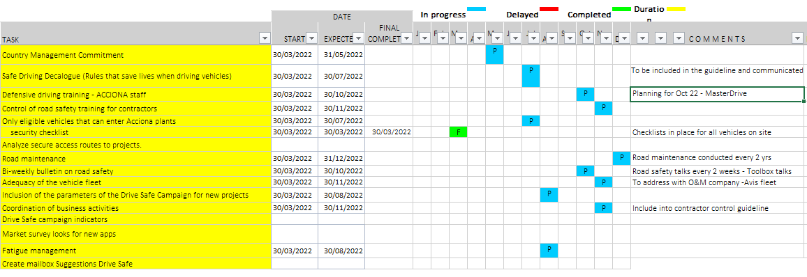
9
PLANNING SOUTH AFRICA

Slide 12
10
PLANNING CHILE
2022 |  | Person Responsible | Jan | Feb | Mar | Apr | May | Jun | Jul | Aug | Sept | Oct | Nov | Dec
Continue Drive Safe programme | Road Safety Guide Update | H&S Sub-management |  |  | X
 | Survey all Acciona drivers and their classification | H&S Coordinators |  |  |  | X | X
 | Training all drivers on the new instructions | H&S Coordinators |  |  |  |  | X | X
 | Plan to carry out the training at each site | H&S Coordinators / QSE Technicians |  |  |  |  |  | X
 | Road Safety Campaign | H&S Sub-management |  |  |  |  |  |  | X
 | Evaluation GPS Production System | H&S Sub-management / Production |  |  |  |  |  |  |  | X | X

Slide 13
11
PLANNING AUSTRALIA

Slide 14
12

Slide 15
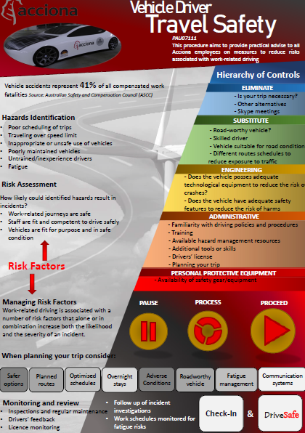
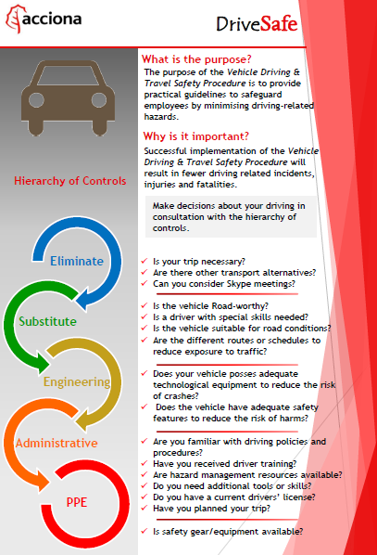
13
DRIVE SAFE IN IMAGES

Slide 16
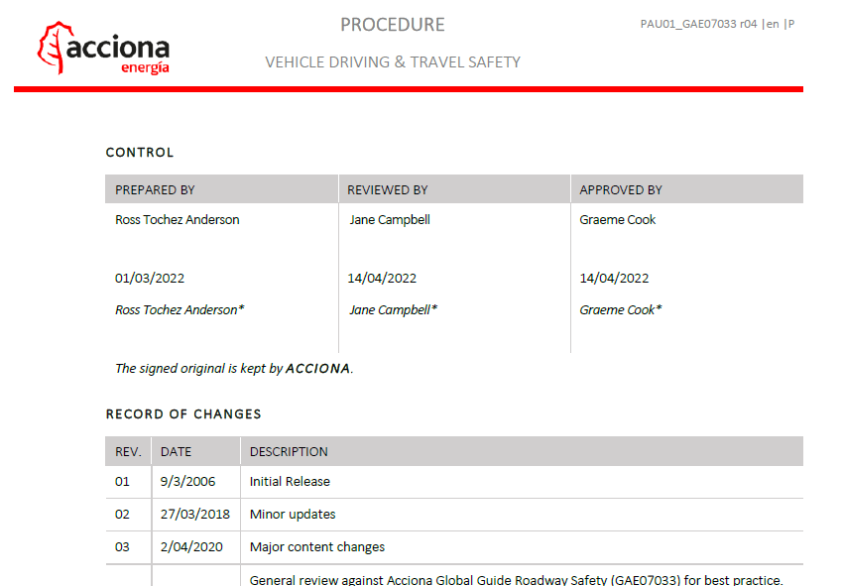
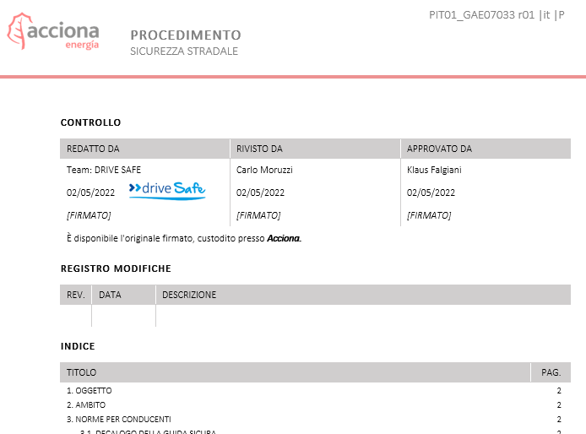
14
DRIVE SAFE IN IMAGES

Slide 17
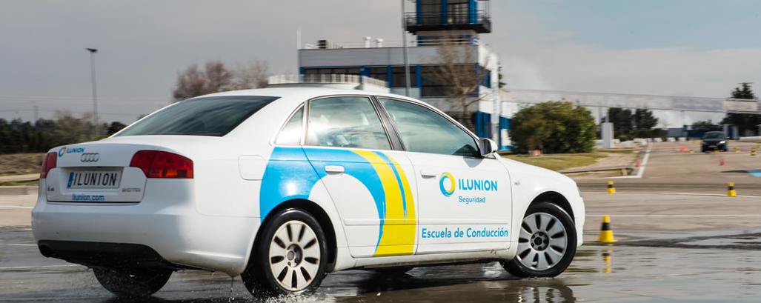
15
DRIVE SAFE IN IMAGES
Nº of employees | People who have done the course in 2021 | People who have to do the course in 2022 | People called | People excluded | People who have done it
1145 | 317 | 828 | 580 | 130 | 112

Slide 18
16
DRIVE SAFE IN IMAGES

Slide 19
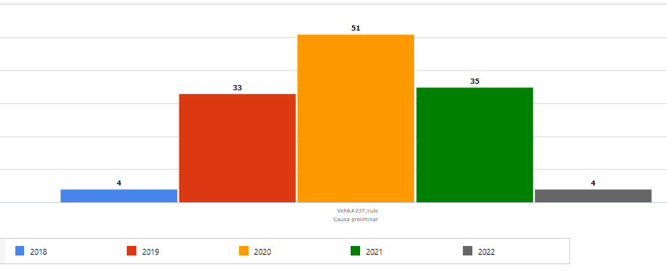
18
DRIVE SAFE IN IMAGES
México

Slide 20
20
AND ALSO…
Focal Point of the project team is identified for weekly follow-up of the status in the country.
  Luis García Garrido – QSES (Leader) → Focal point for South Africa, Mex and Chile
  Santiago Galbet – I&C →Focal point for Australia
  Óscar Vidal – I&C → South Africa
  Unai Legarda – O&M → Focal point for Mex
  José Arregui – O&M → Focal point for Europe
  Abigail Alonso – HR
  Paula Belmar – QSES → Focal point for BRAZIL and PERU

Slide 21
20
AND ALSO….
We have proposed to Chile the roll-out of Drive Safe in Brazil and Peru.
Training was carried out to disseminate the guide in Chile.
Objective: That growth in these new countries be made to the Drive Safe standards
India: Without waiting for the roll-out of Drive Safe they have published their country guide in advance.

Slide 22
21
UPCOMING MILESTONES
Reinforcement of communication campaign.
Acciona Energia's participation in the European Road Safety Awards.
Publication of guides for remaining countries.
Continue monitoring in target countries.
Establish the dashboard in the new countries.

Slide 23
THANK YOU FOR YOUR ATTENTION

