Slide 1
European Road Safety Charter webinar
June 25th
Life on the Road Programme – Two-wheeler school program
Angelika Bíró
biro.angelika@kti.hu
Head of Department
KTI Institute for Transport Sciences

Slide 2
Life on the Road programme
Cooperation for the travelers
Founded:12 April, 2011 by the
Ministry of National Development,
the National Transport Authority,
the National Committee for Accident Prevention and the
KTI Institute for Transport Sciences Non-profit Ltd.
Why was it important?
Focus group research - 42 towns, multi stakeholder attendants
Results: it is strongly recommended to start the education as soon as possible. Those, who have been involved in road safety education before, find it easier to pass their driving test.

Slide 3
Renewal of the road safety education system
Program for road safety education
ÉLET ÚTON-Life on the Road
Principles
the road users with the lifelong learning and collective awareness-raising program become well trained players of the traffic system
With a common (unified) coordination, the previous acts towards road safety become more effective!

Slide 4
Objectives
The main target is to introduce to all age groups the safe and cultured transportation.
Focusing on the children, the program has the following objectives:
Pre-school (kinder garden): introducing and implementing the pedestrian transportation rules with adults (parents).
Grade (basic school children) aged 6-10: independent pedestrian transportation
  age between 12-14: independent transportation by bicycle.
High school children (aged between 14-18): introducing the safe transportation by moped and car, preparations for the moped driving license, and car driving license

Slide 5
The future:
decrease the number of fatal accidents concerning children Life on the Road– ÉLET ÚTON
Vision: In Hungary after 2030 no children - aged under 14 - dies in road safety accident

Slide 6
„Today’s student is the future teacher”
Setting up the basis of a safe and cultured transportation behavior and attitude has to be started in childhood. A well established training in childhood may have great results in the adulthood.
Practice focused teaching!
Direct target group of the program:
toddlers & small children (0-5 yrs.)
basic school children (6-10 yrs.)
grade school children (11-14 yrs.)
high school children (15-18 yrs.)
young adults (19-29 yrs.)
adults (30-64 yrs.)
elderly people (65+ yrs.)
Indirect target group of the program:
The Lifelong Journey program’s professional partners, and the decision makers of these organizations
Teachers/Schools at all levels of education
NGO’s
Driver training professionals
Researchers
Transport experts
University students, the future transport engineers

Slide 7
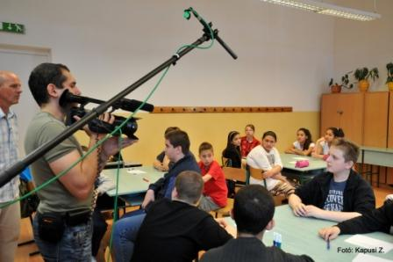
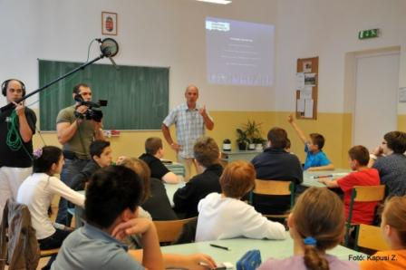
Curriculum for road safety education
Methodological teaching aids for teachers developed by age groups

Slide 8
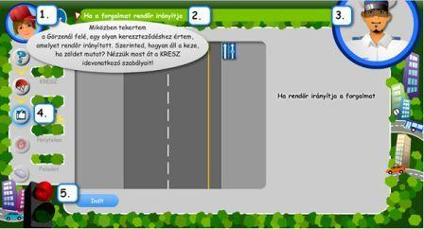
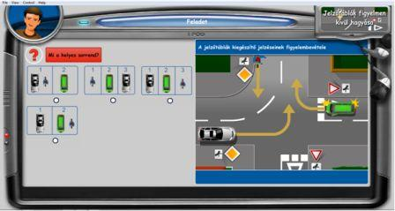
Curriculum for road safety education
E-learning curriculum
Developed by age groups
Travel smart!

Slide 9

Road safety animation films: miniKRESZ

Slide 10
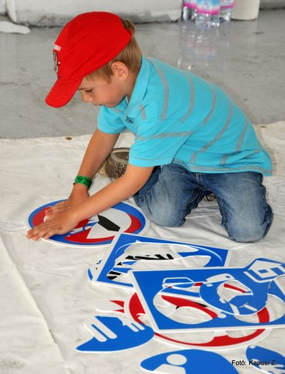
What are the future plans?
To reach our vision
Main targets:
  Increase the safety of the children
  educate well the children, to be cultured and safe road users
  The parents should take care of their children’s road safety and education, so that they would become responsible road users (role models)
  to raise awareness of the need for security, to raise the rule following discipline of passengers
  Grow the transport rule knowledge
  Every child should travel in child seat! (All parents should use the child seat!)

Slide 11
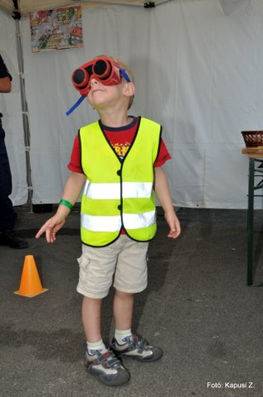
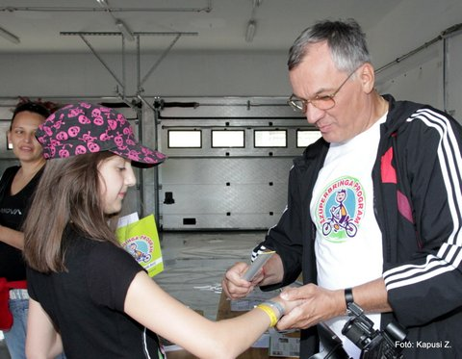
What are the future plans?
Increase the number of children involved in road safety education
The introduction of the “pedestrian license/certification” for 10-years-old children
The introduction of the “bike license” for 12-year-old riders.
Driver training for different categories should contain transport safety module
Strengthen the responsibility of the parents
All parents are required to use child safety devices
Everyone should wear a seat belt while travelling

Slide 12
Two-wheeler school
Road safety program for
13-16 years old students in the frame of Life on the Road programme

Slide 13
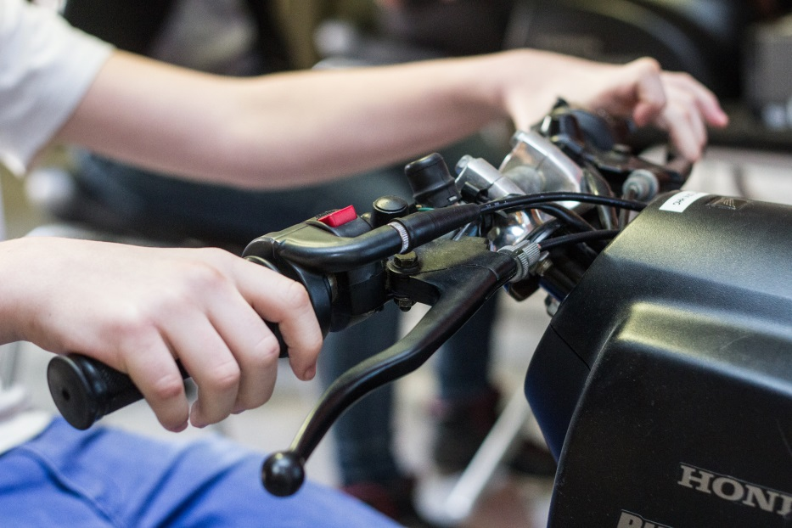
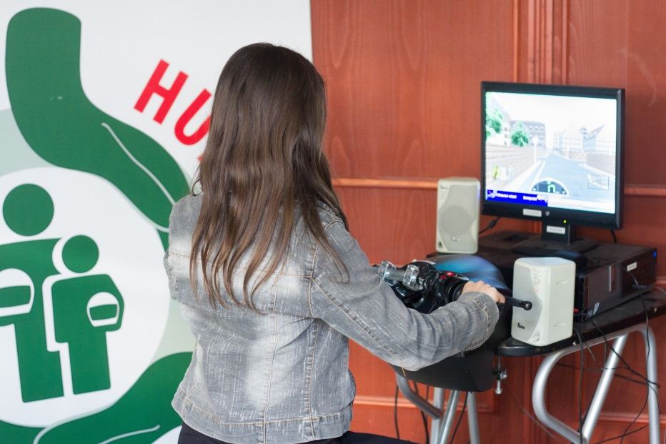
Table of contents
History
Reasons for the training
Connection to Life on the Road Programme
Accident data
Factors affecting the traffic of 15-18 year olds, groups of knowledge
Method and tools of the program
Results of the program

Slide 14
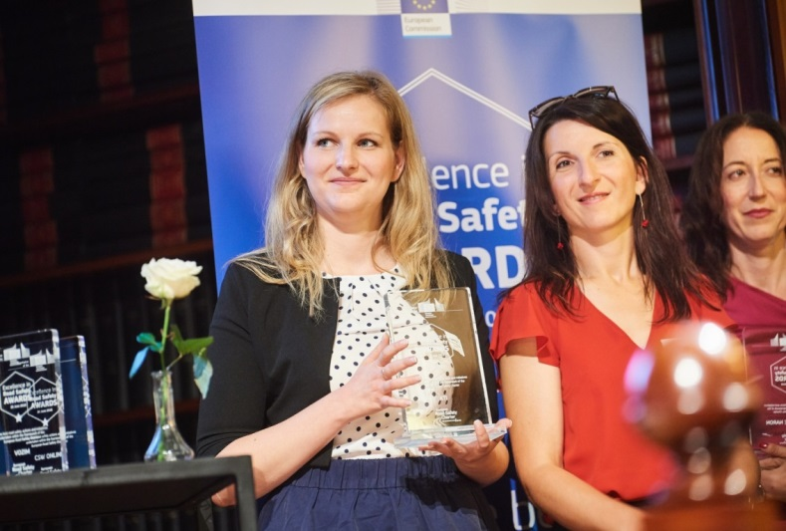
History
Objective: reach as many students as possible in the 13-16 age group, with a road safety and driving training program
In 2018 it is the 5th year it is realized
Reaching 23 000 students in total
Monitoring the road safety knowledge of participant students
Awarded by the jury of the European Road Safety Charter for the “Excellence in Road Safety”

Slide 15
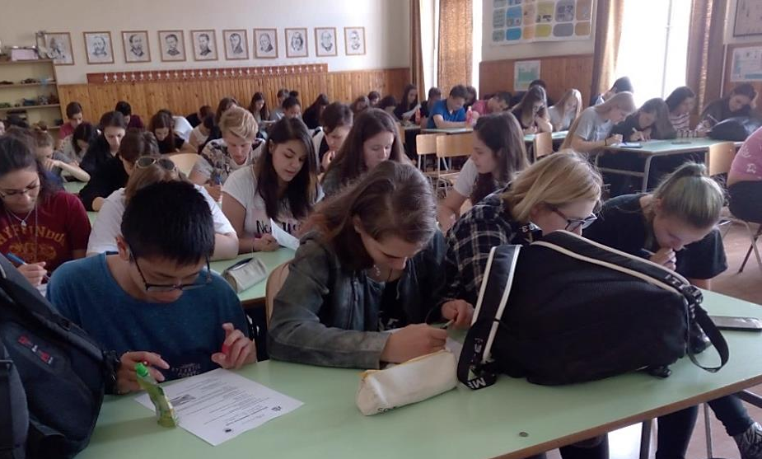
Reasons for the training
Experts say there is a very clear link between education and driving training. Those who have been trained in pre-school education can much easier learn to drive. It is important to emphasize that children become independent drivers:
By bike, from 12 years of age
By moped even from 14 years of age
Proper preparation is essential for their safe transport.

Slide 16
Connection to the Life on the Road Programme
Our objectives in the Life on the Road Programme:
To improve the safety of children,
To training them to cultured, well-prepaired and safe transport,
To be aware of the need for safety
To increase willingness to follow the rules,
To improve transport culture.
In line with the goals it is important
to draw the attention of the road user groups to the importance of the technical equipment and safety of the vehicle.

Slide 17
Factors affecting 13-18 year olds transportation

Slide 18

Factors affecting 13-18 year olds transport
Moped transport availability from the age of 14 years
Driving licens from 18 years of age
rebellion period, new behavioral patterns, dressing
Reviewing values and rules
Analysis and application of causal relationships
Searching exemplar
Define theirselves
CONCLUSIONS:
Teenager, trying everything – can be receptive for
road safety
Putting the right thinking into the group
norm, way of thinking
Choosing the right communication channel
Messaging with icons and idols

Slide 19
Messages for the target group
MESSAGES
FOR HIGH SCHOOL STUDENTS | FOR TEACHERS
Get a driving license! Safe traffic is important for XY (known young star). Follow his/her example! Safe traffic is not embarrassing! | Involve your students in as much traffic competition as possible, motivate them! Be their partner (not their teacher) in it!

Slide 20
Knowledge groups for this age group
Short description of accident statistics, number of people killed in traffic accidents
Cycling rules
Information on obtaining a license: for categories AM, B, B125
Visibility
Perception of distance and speed of approaching vehicle
Manufacturers Accident Prevention Concept
Writing a Bicycle Knowledge Test Before and after the Presentation (10-10 questions)
Videos (consulting previously with the teacher)

Slide 21
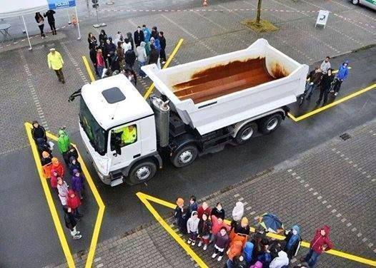
Groups of knowledge for this age group
Attention sharing, distraction tools
  Listening to music
  Using of mobile phone, etc.
Compulsory equipments on the vehicle (bike, moped)
Protecting equipment (bike, moped)
Knowledge of priority rules, knowledge of the most
important traffic signs
Vehicle management
  Avoiding emergency
  reflexes
  Technical equipment, troubleshooting
Blind spots os vehicles – where to take care
ourselves most
Behaviour with alcohol influenced driver
Driving under the influence of alcohol
Rules of passenger transporting on moped
and bike
Mainstream conduct, responsible traffic, following the rules

Slide 22
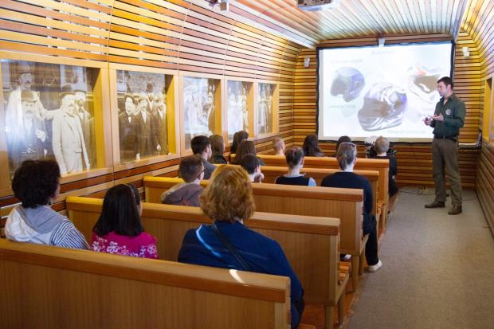
Methods and tools of the program
Professional and experienced instructors
Interactive training
Attitude testing(15 minutes survey before training)
Before training 5 minutes knowledge test
Training by knowledge groups,
presentations, videos, presenting
demonstration tools
Short eduational films
After training knowledge test
Riding trainer or bike traffic experience
In 2018 41 schools,
reaching 6150 students in total

Slide 23
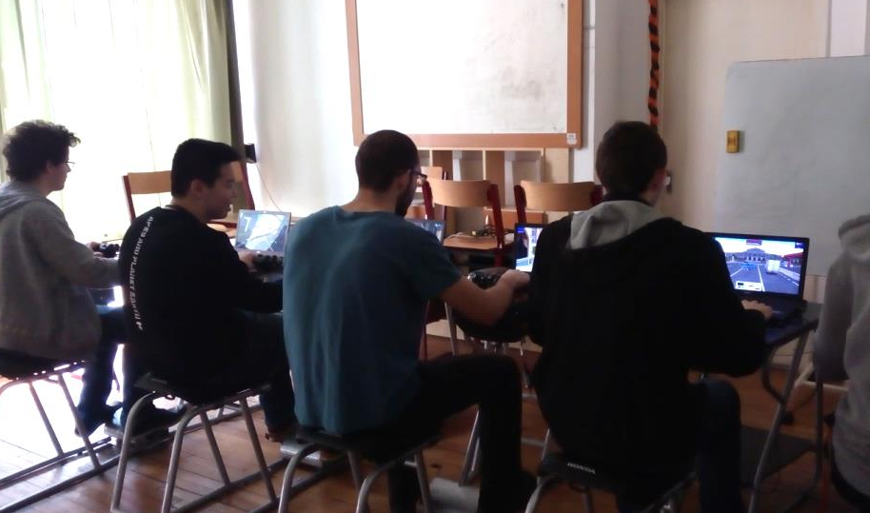
Methods of the program
Riding Trainer
  They can experience traffic situations, dangerous for bikers and moped users under safe circumstances
  Their task is to avoid, prevent these situations
  After a track, they get concrete evaluation, reviewing the errors
  Every student could „drive” 3-5 rounds
  Aiming as long and as effective practising as possible

Slide 24
Experiences– 2018
Training has had a positive impact on students' average level of knowledge.

Slide 25
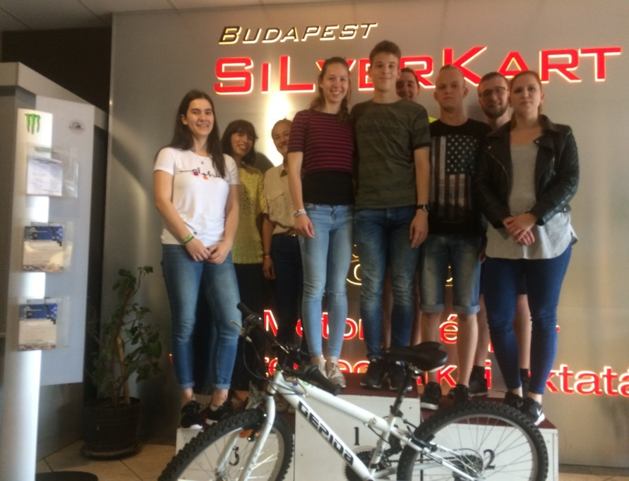
Closing event – III. National Cycling and Moped Safety and Vehicle Management Competition
Tender - Making a road safety poster
Among best applicants bike-scooter competition:
  Cycling skill track
  Cycling on plank– balance practice
  Traffic test
  Honda Riding Trainer virtual
  riding on scooter with simulator
  in urban traffic

Slide 26
Literature used
Road Safety Program for Graduate School and Business School students KTI Institute for Transport Sciences Non-Profit Ltd Road Safety Research Center
Two wheeler school - Road Safety Program for Primary school and Graduate school Students KTI Institute for Transport Sciences Non-Profit Ltd
Life on the Road Programme Strategy KTI Institute for Transport Sciences Non-Profit Ltd Road Safety Center
KSH - Central Statistics Office Hungary

Slide 27
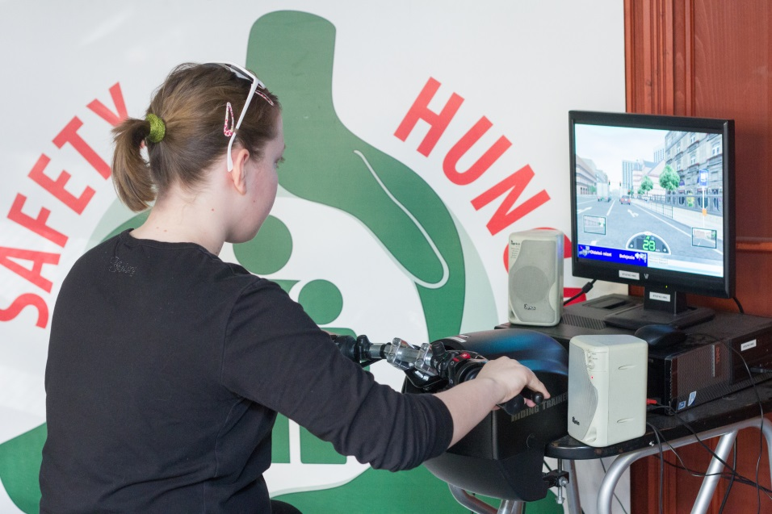
Thank you for your attention!
Angelika Bíró
biro.angelika@kti.hu
Head of Department
KTI Institute for Transport Sciences Nonprofit Ltd.
Road Safety Research Centre
Road Safety Education Department

